Slide 1
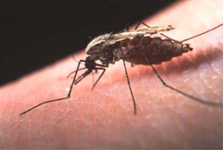
Professor Quazi Tarikul Islam
FCPS, FACP, FRCP(Edin. Glasg.), MACP
Professor of Medicine
Popular Medical College &Hospital
Editor in Chief
National Guideline for Clinical management
of Dengue Syndrome 2018

Slide 2
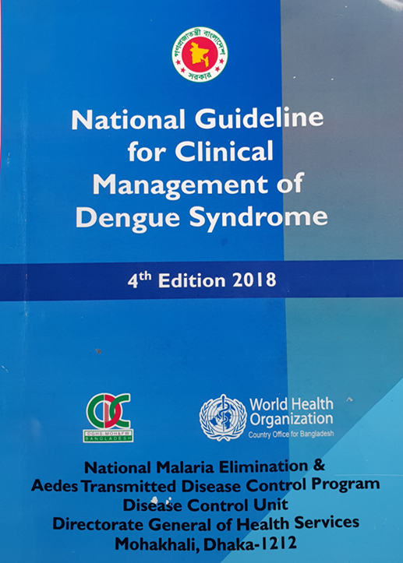
New guideline 2018

Slide 3
Dengue Cases and Death- 2000 to September 2018

Slide 4
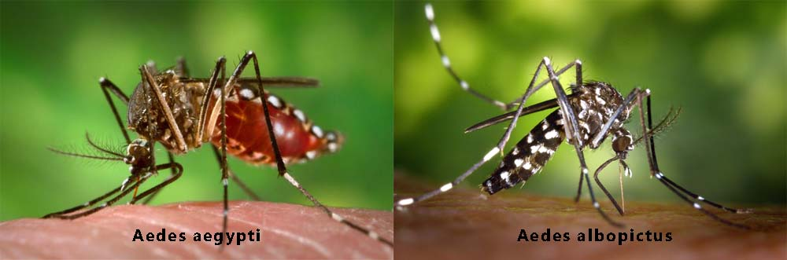
Responsible vectors for DENV

Slide 5
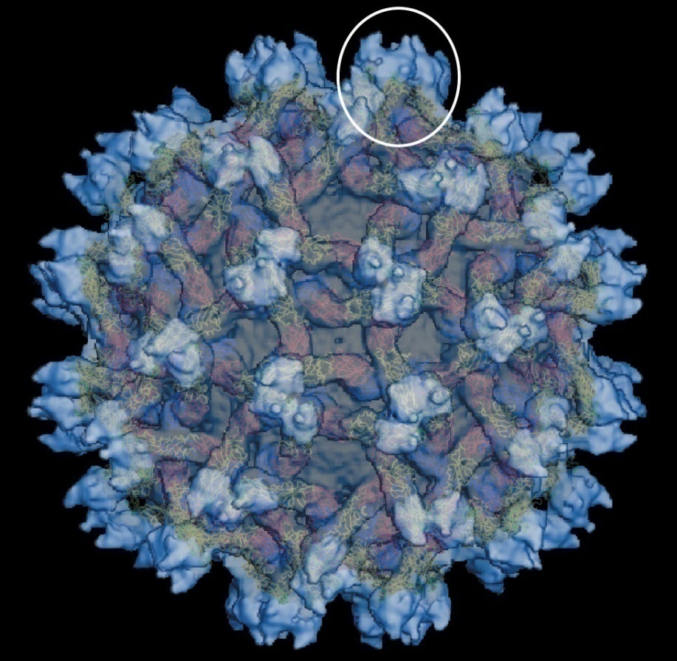
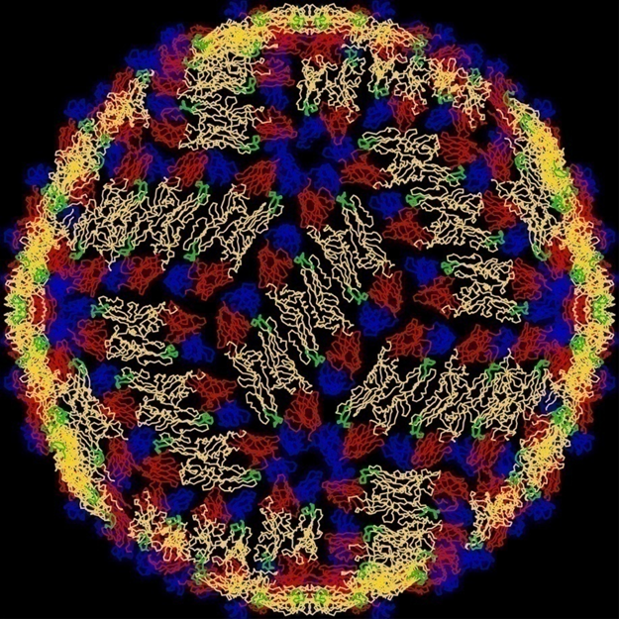
Responsible dengue viral particles

Slide 6
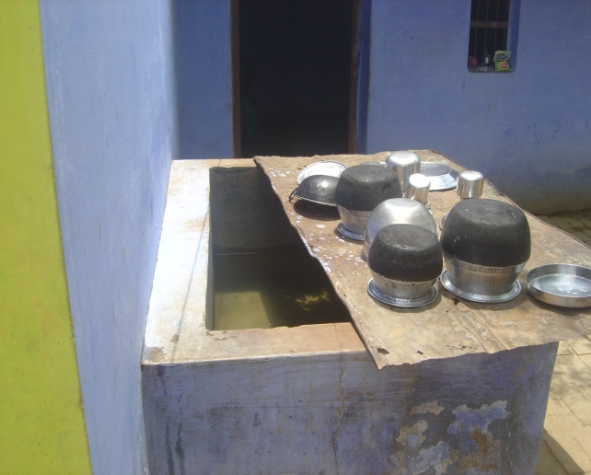
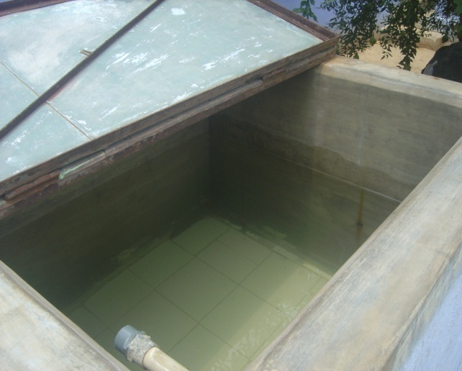
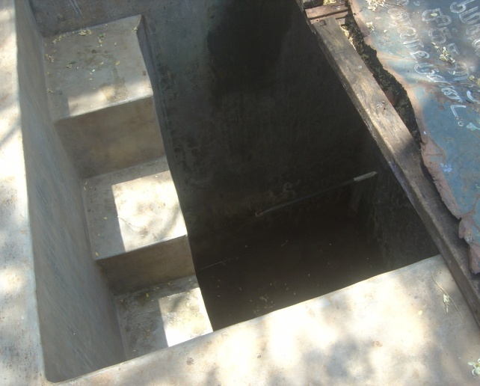
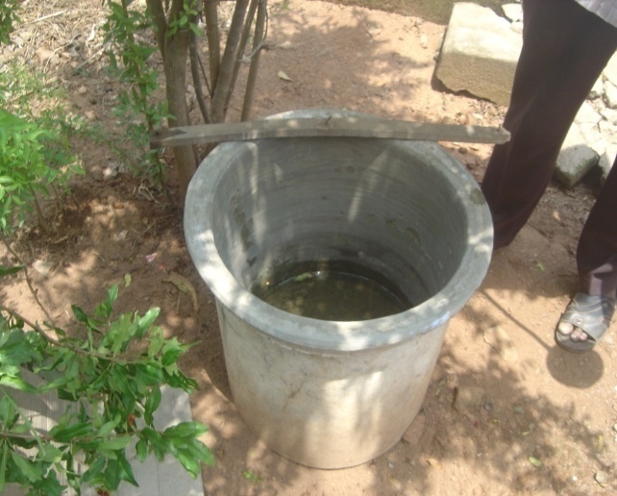
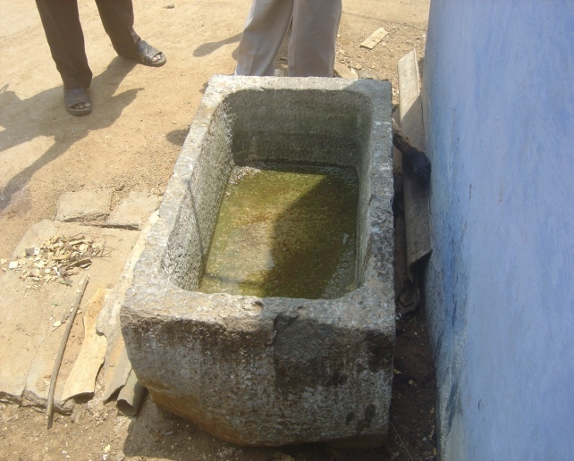
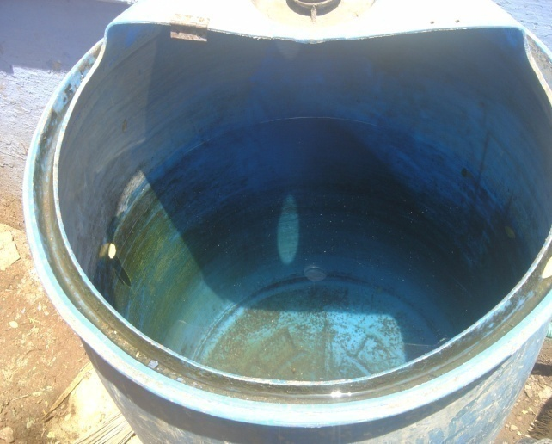
Storage related

Slide 7
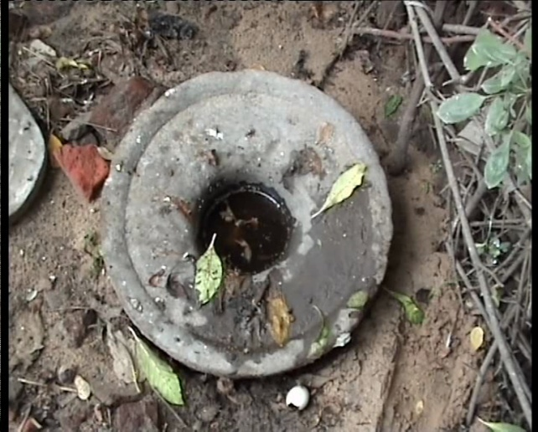
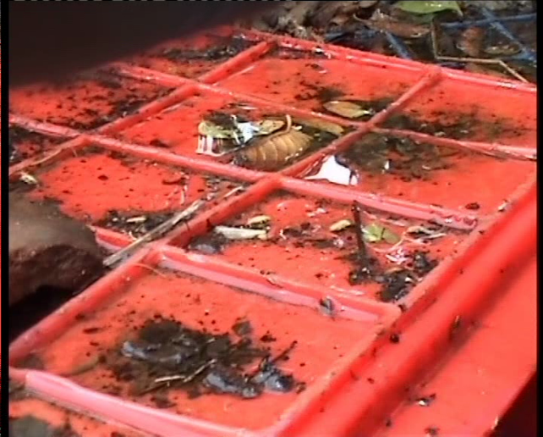
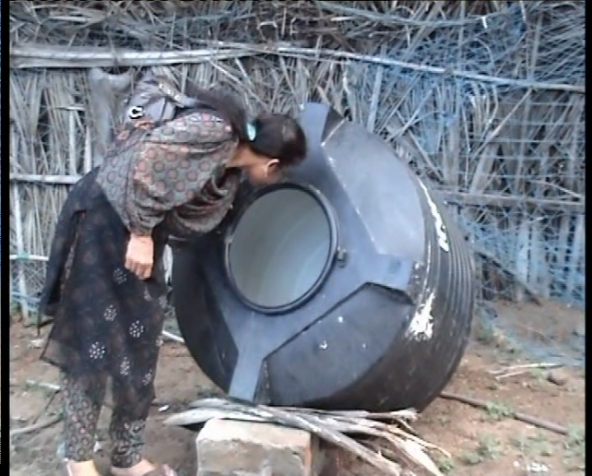
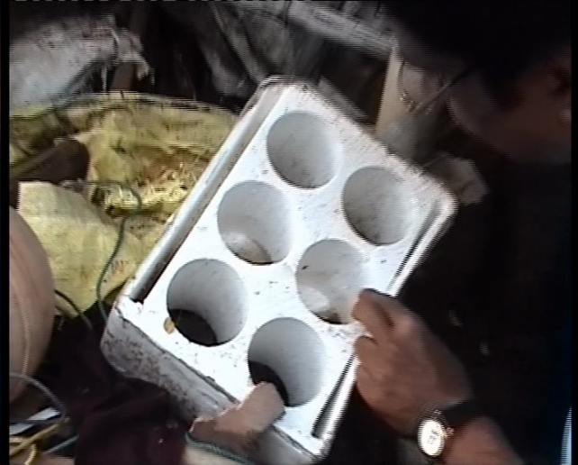
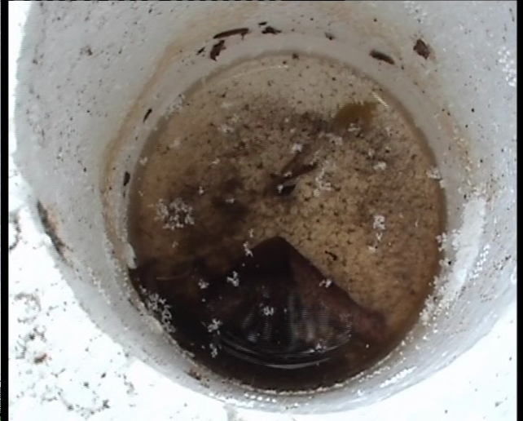
Rain-fed

Slide 8
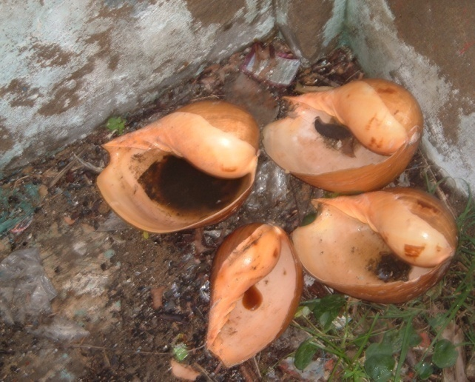
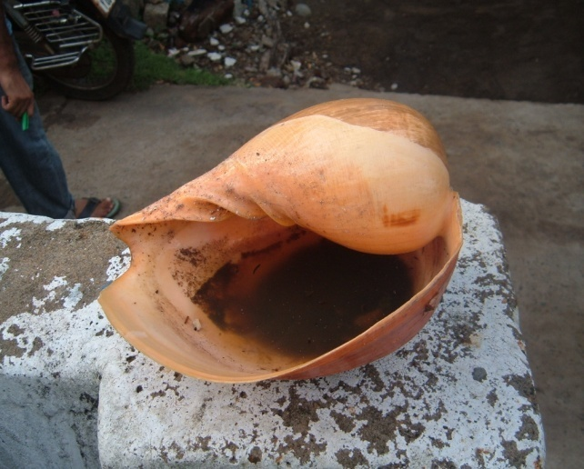
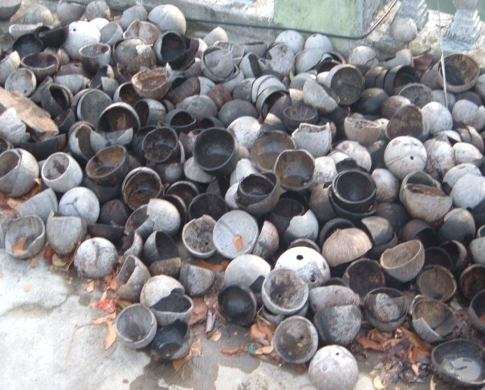
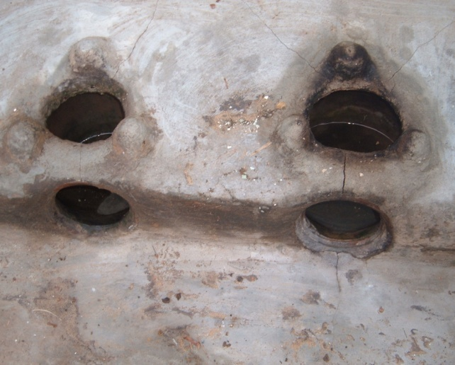
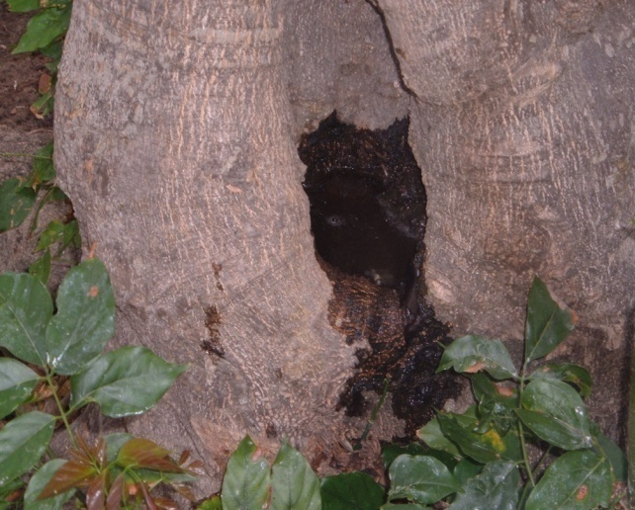
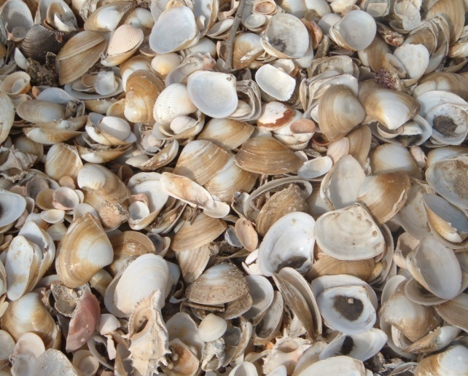
Coastal areas

Slide 9
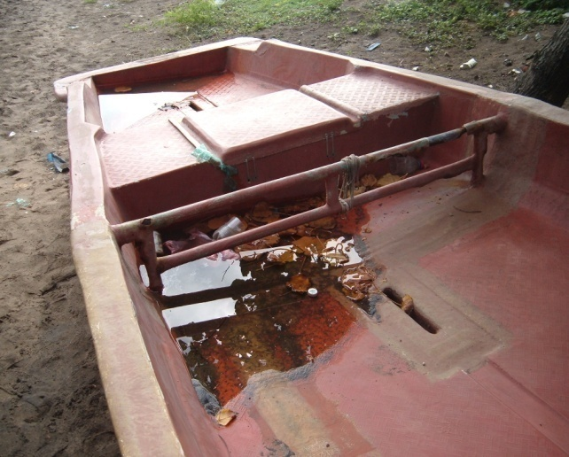
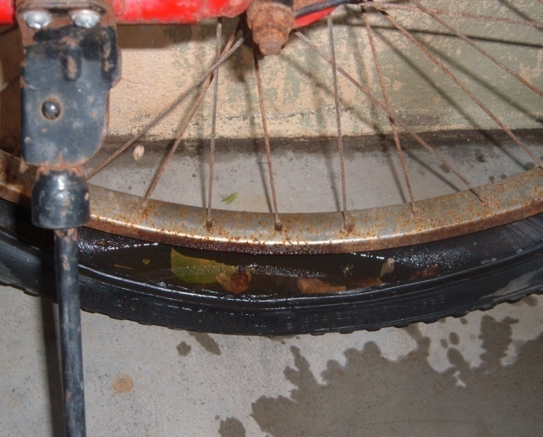
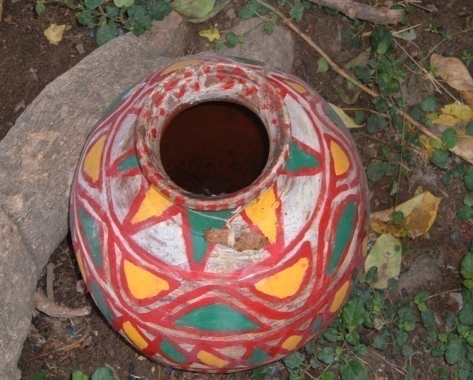
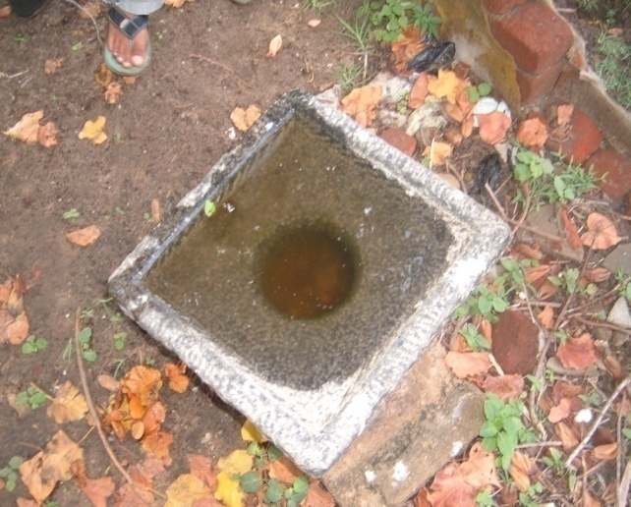
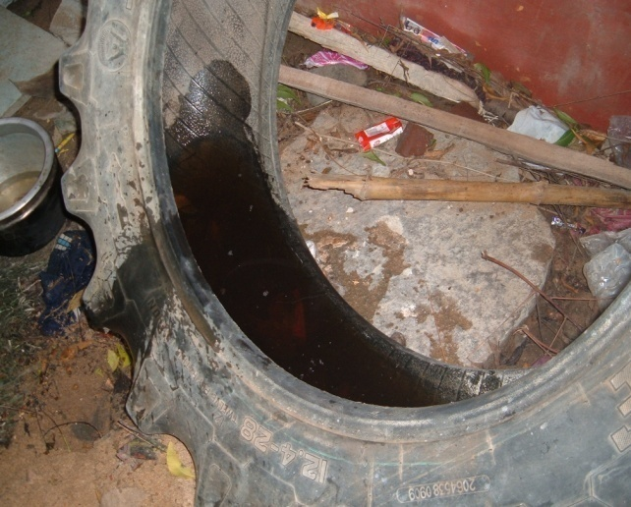

Slide 10
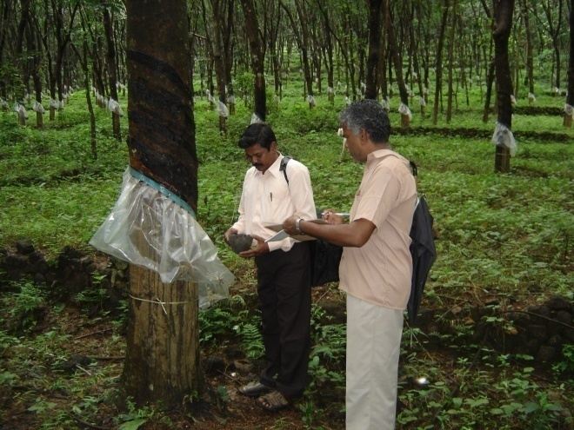
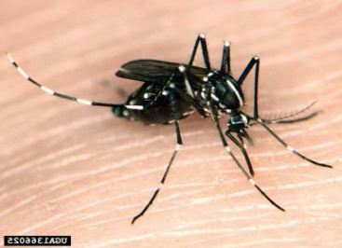
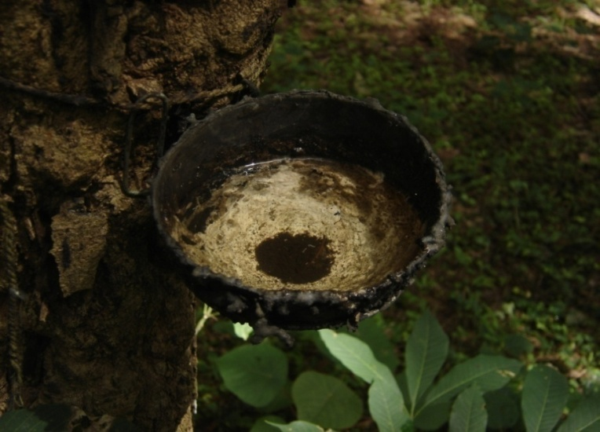

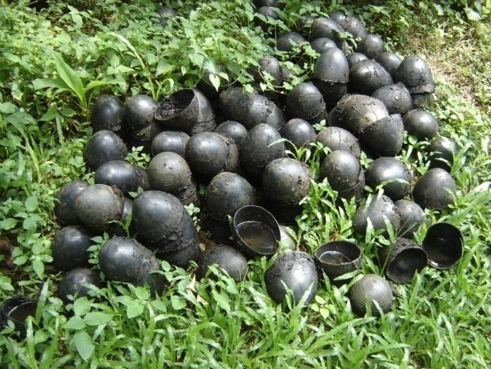
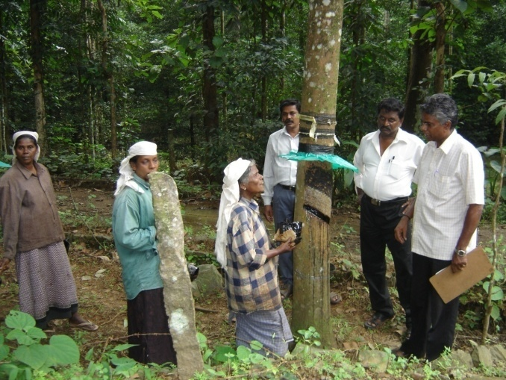
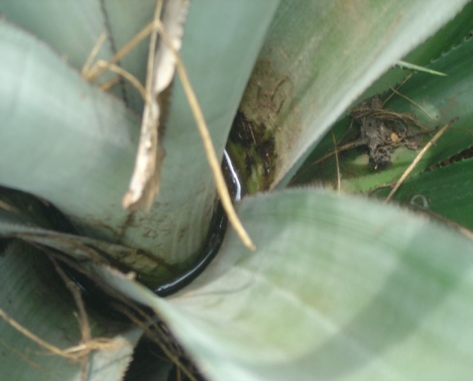
Aedes albopictus in rubber plantations

Slide 11
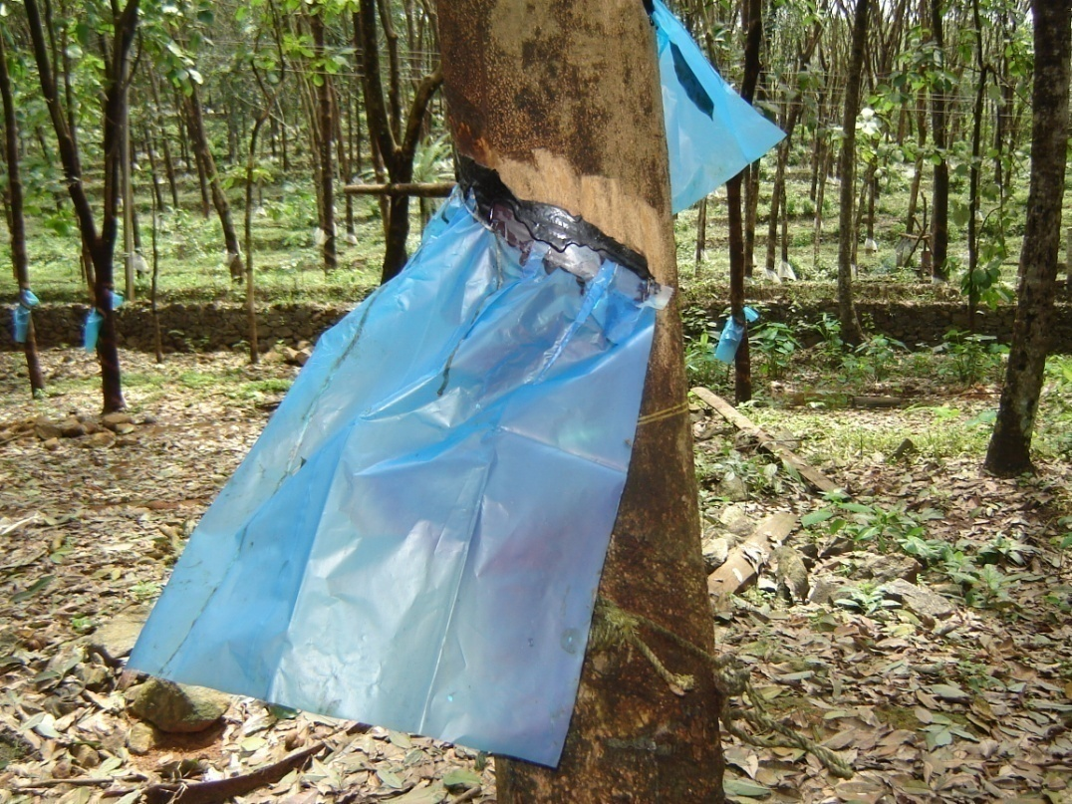
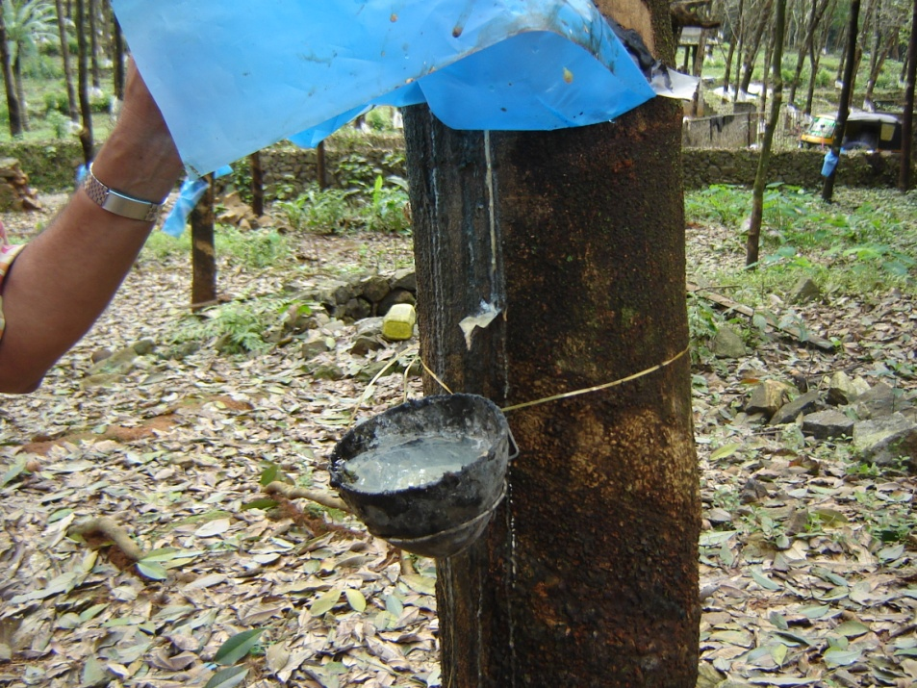
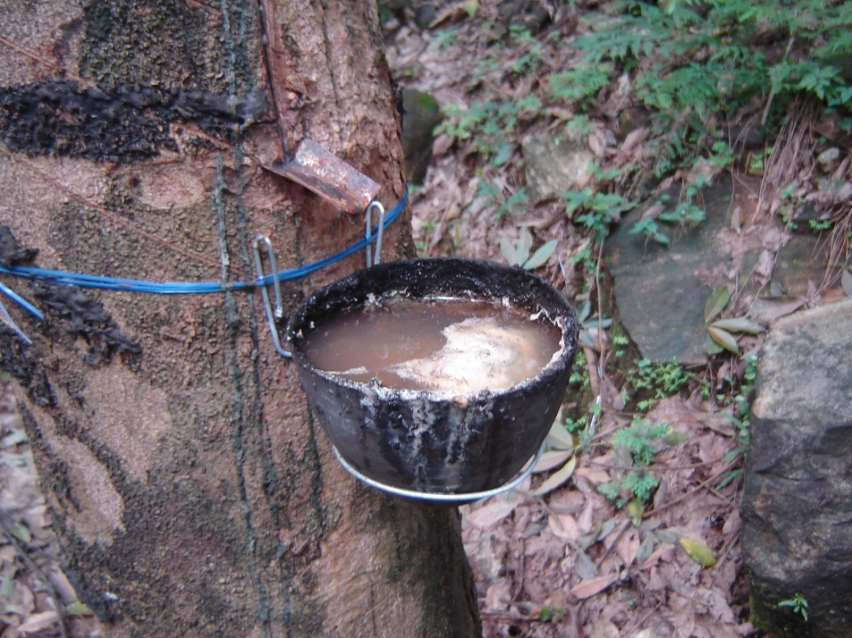
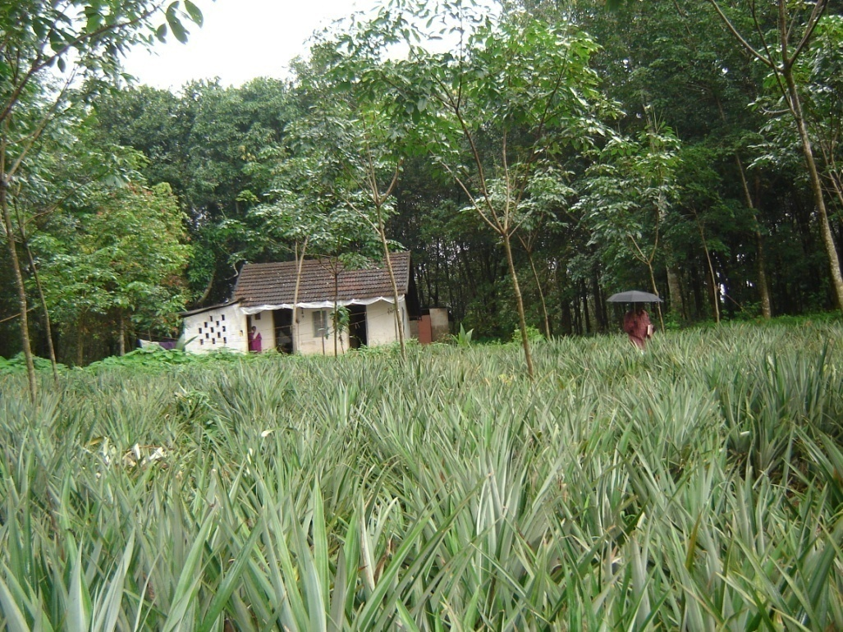

Slide 12
Tissue Tropism
Many cell types can be infected in vitro with DENV: monocytes, epithelial cells, endothelial cells, hepatocytes, myocytes.
Evidence of in vivo infection: presence of antigen, genome, active replication (negative viral RNA), in tissue samples.

Slide 13
PRIMARY INFECTION
T
SECONDARY INFECTION
Chemokines
Cytokine
Tsunami
CYTOKINES
SHOCK!

Slide 14
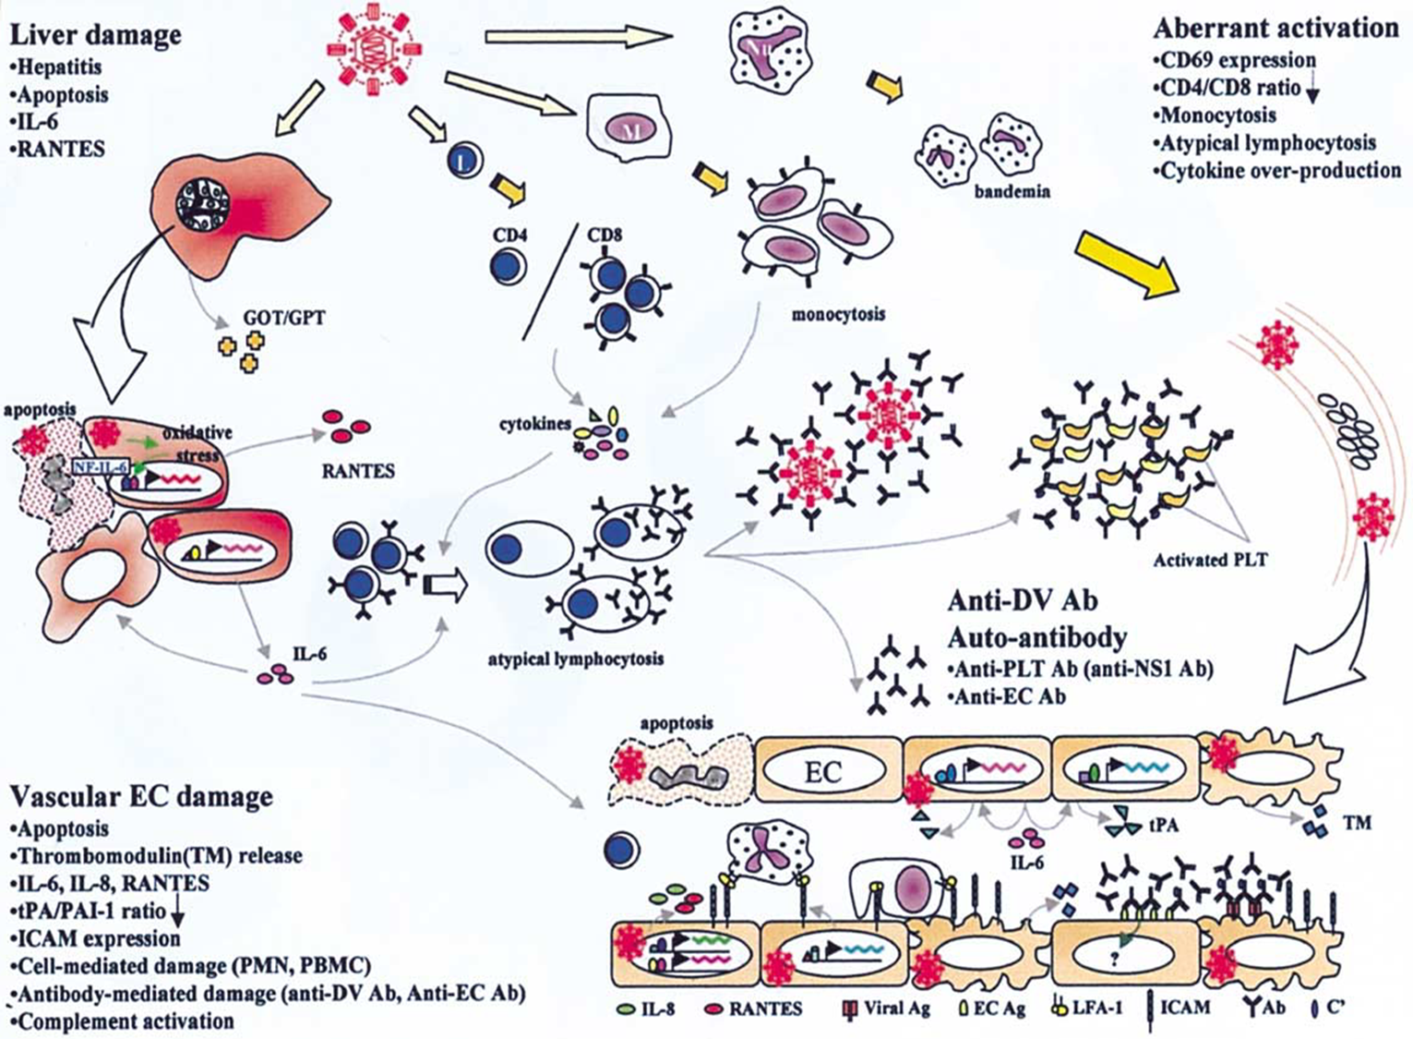

Slide 15
memory T cells
preexisting
antibodies
Target cells
(monocytes.
dendritic cells)
Viral products
Immune complexes
complement Activation
Pro-inflammatory
cytokine release
cytokine release
Blood vessels
permeability

Slide 16
Why study pathogenesis?
To develop predictive indicators or profiles of severe disease.
To develop therapeutic interventions.
To identify protective and pathogenic immune correlates.

Slide 17
Host factors
Immune
Antibodies Cellular
-neutralizing -NK cells
-ADCC
-enhancing ? Cross-reactive T cells
Genetics
HLA, TNF, CD209
Viral factors
-viral burden
-virulence ?
Type I IFN response
Viral burden
Cellular immune activation
Pro-inflammatory mediators
Cellular membrane
Molecules, receptors
Angiogenic
mediators
Vascular permeability

Slide 18
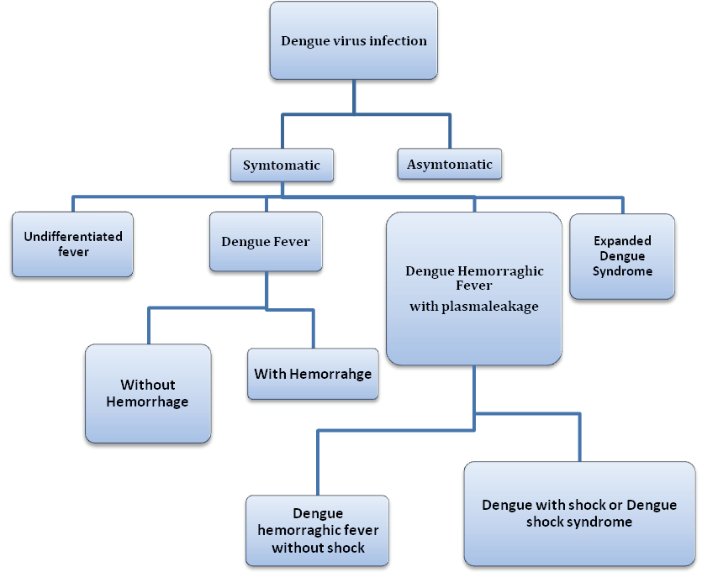

Slide 19
Dengue virus infection
10,000
Asymptomatic Symptomatic
Viral syndrome Dengue fever DHF
9,000
1,000
500
400
100
Plasma leakage
Expanded dengue syndrome (Uncommon)
Prolonged shock: liver failure,
renal failure,…Encephalopathy…
  Co-morbidities
  3. Co-infections
  4. True dengue infection - encephalitis
DHF
DSS
1-2

Slide 20
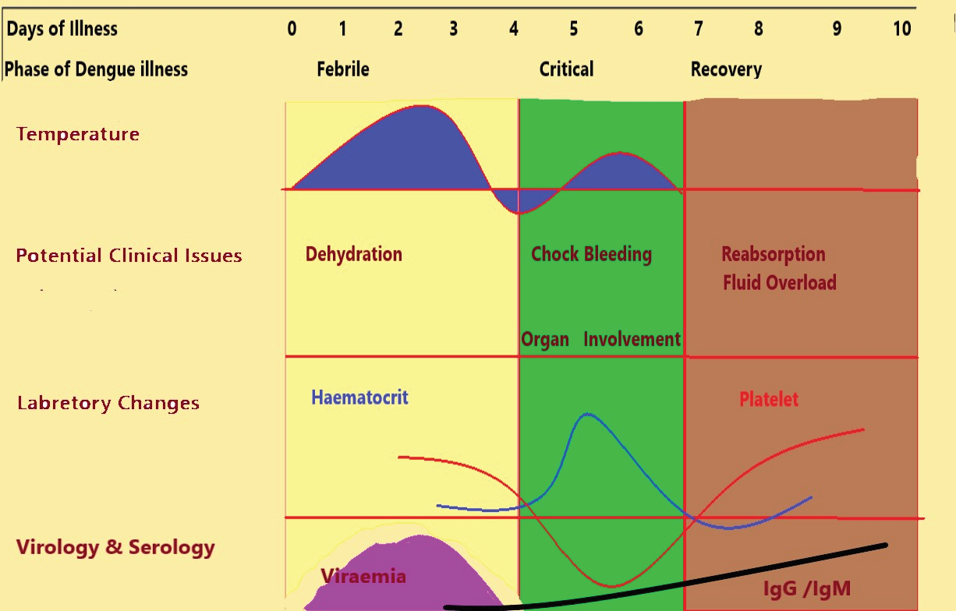

Slide 21
Clinical features of dengue infection
Dengue
Systemic
Bleeding
diathesis
Vascular
permeability
Hepatic
Other
(rare)
Fever
Malaise
Headache
Muscle/joint
pain
Rash
Fatigue
Thrombocytopenia
Tourniquet test
Petechiae
Coagulopathy
Gross bleeding
Plasma leakage
Hemoconcentration
Pleural effusion
Ascites
Elevated
transaminases
Encephalopathy
Liver failure
Shock

Slide 22
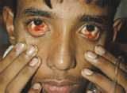
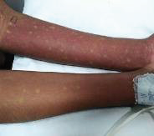
Clinical course
The clinical course of illness passes through the following three phases:
• Febrile phase
• Critical phase
• Convalescent phase
Conjunctival hemorrhhage
convalescent rash

Slide 23
Dengue fever
Typically, the onset of DF is sudden with a sharp rise in temperature and is frequently associated with a flushed face and headache. Occasionally, chills accompany the sudden rise in temperature. The following features are usually observed:
retro-orbital pain on eye movement or eye pressure
photophobia
backache, and pain in the muscles and joints/bones.
The other common symptoms include anorexia and altered taste sensation, constipation, colicky pain and abdominal tenderness

Slide 24
Fever and Rash
Fever: The body temperature is usually between 39 °C and 40 °C (102° F to 104° F) and the fever may be biphasic(“Saddleback”,) lasting 2–7 days in the majority of cases.
Rash:
First 2 to 3 days - Diffuse flushing or fleeting eruptions may be seen on the face, neck and chest
Third and fourth day- a conspicuous rash that may be maculopapular or rubelliform
Afebrile period or defervescence - Petechiae surrounding scattered pale, round areas of normal skin may appear over the dorsum of the feet, on the legs, and on the hands and arms. Skin itching maybe observed.

Slide 25
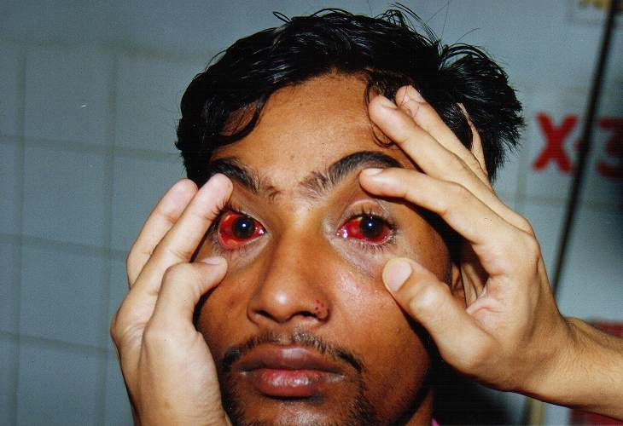
SUB CONJUNCTIAL HAEMORRHAGE

Slide 26
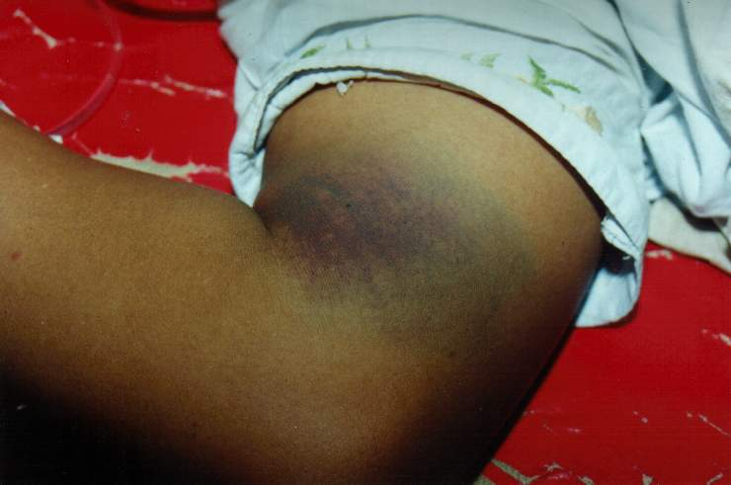
SUB CUTENOUS BLEEDING

Slide 27
Evidence of Plasma leakage
Haematocrit (HCT) - With the leakage of plasma there will increase in HCT. A 20% rise of HCT from the baseline is indicative of significant plasma leakage.
Plasma leakage is due to increased capillary permeability.
Plasma leakage in DHF is selective and transient and usually lasts for 24-48 hours.
Ascites and pleural effusion may develop.
Other evidence of plasma leakage are:
non-fasting serum cholesterol (<100 mg/dl).
The degree and the rate of plasma leakage in DHF can vary.
Severe leakage may develop shock, which may be complicated with organ impairment, metabolic acidosis and disseminated intravascular coagulation (DIC)
A right lateral decubitus chest radiograph to detect pleural effusion and gall bladder wall oedema is associated with plasma leakage and may precede the clinical detection.

Slide 28
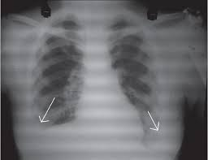
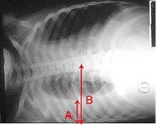
Imaging-
Chest X-ray (P/A, lateral decubitus view)

Slide 29
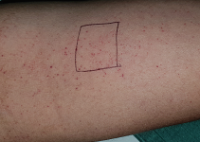
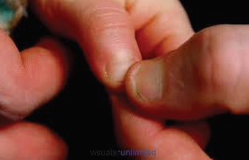
Tourniquet Test (TT) and Capillary Refill Time(CRT)
Tourniquet Test (TT)
Capillary Refill Time

Slide 30
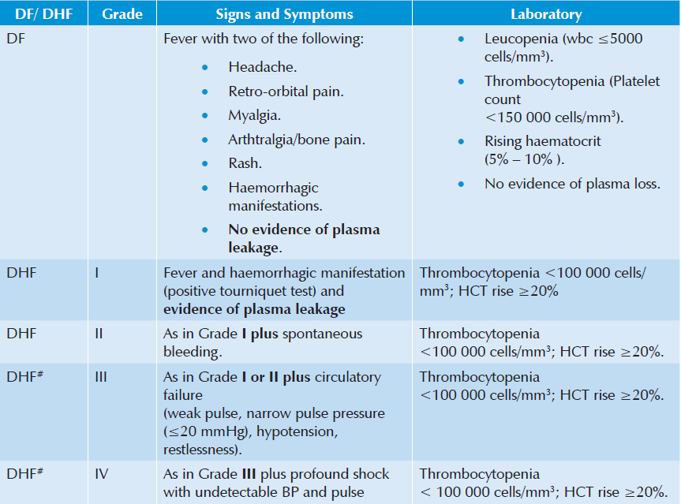
WHO classification of dengue infections and grading of severity of DHF ( Obsolate Now)

Slide 31
Dengue Case Classification by Severity
This clinical guide uses three categories for case management:
1.Group –A ( mild)
2.Group- B (Moderate)
3. Group – C (Severe)

Slide 32
Patients Group A : Dengue Patient without warning sign.
Patient Group B : Dengue Patient with warning sign.
Patient Group C: Dengue Patient with critical phase of the disease

Slide 33
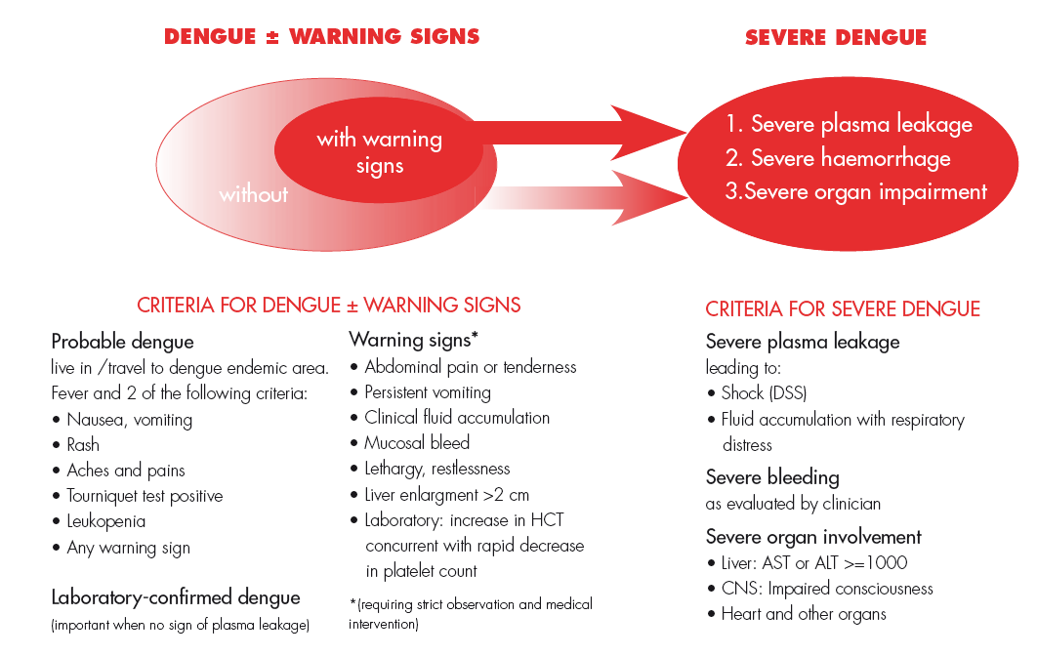

Slide 34
Management According to Group A-C

Slide 35
Group – A (May be sent at home)
Group-A criteria:
    Patient who don’t have warning sign
    And
    Who are able-
    -to tolerate adequate amount of ORAL fluids
    -to pass urine at least once in every 6 hours

Slide 36
Group-A (Laboratory test)
Complete Blood Count (CBC)
Hematocrit (HCT)
SGOT/SGPT
NS1 antigen for Dengue ( upto 5 days of onset of fever)

Slide 37
GROUP –A (Management)
Adequate bed rest
Adequate fluid intake (> 6 glasses for an average-sized adult) - e.g. milk, fruit juice (caution with diabetes patient), oral rehydration solution (ORS) or barley/rice water/coconut water Note: Plain water alone may cause electrolyte imbalance
Take paracetamol (not more than 3 grams per day for adults)
Tepid sponging
Look for mosquito breeding places in and around the home and eliminate them

Slide 38
Group –A
DO NOT TAKE
Acetylsalicylic acid (aspirin), mefenemic acid , ibuprofen or other
NSAIDs
Steroids
Antibiotics

Slide 39
Group –A (Monitoring)
Daily review for disease progression:
- To do CBC daily and report at OPD
-Defervescence
- Warning signs (until out of critical period)
Advice for immediate return to hospital if development of any warning signs
Written advice of management (home care card for dengue)

Slide 40
Group-B (Hospital Care)
Group Criteria:
Patient with any of the following features:
Co-existing conditions such as pregnancy, infancy, old aged, DM
Social circumstances such as living alone, living far from hospital.
OR
existing warning signs

Slide 41
Group - B (Laboratory Test)
Full blood count (FBC)
Haematocrit (Hct)
SGOT/SGPT
Dengue serology (if fever is more than 7 days)
RBS, S.Creatinine, Electrolyte, CXR, USG of Abdomen ( Optional)

Slide 42
Group B : Cont.
Indications for IV fluid:
when the patient cannot have adequate oral fluid intake or is vomiting.
HCT continues to rise 10%–20% despite oral rehydration.
impending shock/shock.

Slide 43
General principles of Fluid therapy
Crystalloids
1. 0.9% Nacl (isotonic normal saline solution) (0.9%NS) (Preferable)
2. 0.45% half strength normal saline solution (0.45%NS) (For children)
3. 5% dextrose in lactated Ringer's solution (5%DRL)
4. 5% dextrose in acetated Ringer's solution (5%DRA)
5. Hartman solution (Preferable)
Colloids
1. Dextran 40
2. Hemaceel
3. Plasma
4. Blood & Blood Components
5. Human Albumin

Slide 44
Group –B ( Fluid consideration)
Isotonic crystalloid solutions should be used throughout the critical period except in the very young infants <6 months of age in whom 0.45% sodium chloride may be used.
Hyper-oncotic colloid solutions (osmolarity of >300 mOsm/l) such as dextran 40 or starch solutions may be used in patients with massive plasma leakage, and those not responding to the maximum volume of crystalloid. Iso-oncotic colloid solutions such as blood and blood component may not be as effective.

Slide 45
Group –B ( Fluid consideration)
A volume of about maintenance +5% dehydration should be given to maintain “just adequate” intravascular volume and circulation.
The duration of intravenous fluid therapy should not exceed 24 to 48 hours for those with shock. However, for those patients who do not have shock, the duration of intravenous fluid therapy may have to be longer but not more than 60 to 72 hours.

Slide 46
Group- B (Fluid Requirement)
The fluid requirement, both oral and intravenous, in critical phase (48 hours) is calculated as M+5% (maintenance + 5% deficit).
5% deficit is calculated as 50 ml/kg up to 50kg.

Slide 47
Calculations for normal maintenance of intravenous fluid Infusion:
Normal maintenance fluid per hour can be calculated on the basis of the following formula* (equivalent to Holliday - Segar formula):
4 ml/kg/hr for first 10 kg body weight + 2 ml/kg/hr for next 10 kg body weight + 1 ml/kg/hr for subsequent kg body weight

Slide 48
Fluid Management of Patients in Group B:
For example, in a child weighing 20 kg, the deficit of 5% is 50 ml/kg x 20 = 1000 ml. The maintenance is 1500 ml for one day. Hence, the total of M + 5% is 2500 ml. This volume is to be administered over 48 hours in non shock patients.
The rate of IV replacement should be adjusted according to the rate of plasma loss, guided by the clinical condition, vital signs, urine output and hematocrit levels.

Slide 49
The admitted patient (Category B) should be started with recommended fluid at a rate of 1.5ml/kg/hr or 40ml/hr (12 d/min) for adults and should be given for 6 hours.
If patients vital signs is stable, then the escalation of fluid is not needed and the same rate can be maintained for a period of 48 hours.

Slide 51
Platelet transfusion :
Platelet transfusion is not recommended for thrombocytopenia (no prophylaxis platelet transfusion).
The indication of which may be as follows:
1. Very severe Thrombocytopenia who needs urgent surgery.
2. Clinical judgement of the treating physician
If platelet concentrate is not available fresh whole blood may be transfused as per guidelines given under DHF management

Slide 52
Group C:
Group Criteria, Patient with any of the following features:
Severe plasma leakage with shock or /and fluid accumulation with resp. distress
Severe bleeding
Severe organ impairment
Severe metabolic dysfunction

Slide 54
Group C : Laboratory Test
Full blood count (FBC)
Haematocrit (Hct)
SGOT/SGPT
Dengue serology (if fever is more than 7 days)
RBS, S.Creatinine, Electrolyte, CXR,
USG of Abdomen ( Optional)
Other organ function test as indicated

Slide 55
Group C :The goals of fluid resuscitation:
Improving central and peripheral circulation – i.e. decreasing tachycardia, improving BP and pulse volume, warm and pink extremities, capillary refill time < 2 seconds;
improving end-organ perfusion – i.e. achieving a stable conscious level (more alert or less restless)
urine output ≥ 0.5 ml/kg/hour or decreasing metabolic acidosis.

Slide 56
Group C: Compensated shock
DSS is hypovolemic shock caused by plasma leakage and characterized by increased systemic vascular resistance, manifested by narrowed pulse pressure (systolic pressure is maintained with increased diastolic pressure, e.g. 100/90 mmHg).
When hypotension is present, one should suspect that severe bleeding, and often concealed gastrointestinal bleeding, may have occurred in addition to the plasma leakage.

Slide 57
Group C:Compensated shock (Cont.)
Most cases of DSS will respond to 10 ml/kg in children or 300–500 ml in adults over one hour or by bolus
It is essential that the rate of IV fluid be reduced as peripheral perfusion improves; but it must be continued for a minimum duration of 24 hours and discontinued by 36 to 48 hours.
Excessive fluids will cause massive effusions due to the increased capillary permeability.

Slide 59
Group-C: Decompensated Shock
Characterized by DSS + profound hypotension
Preferably this group of patient need to mange in ICU setting
Oxygen should be started immediately
The bolus 10-20 ml/kg crystalloids should be given within 15-30 min

Slide 60
Group-C: Decompensated Shock(Cont.)
If there is no clinical improvement after bolus crystalloids, check HcT. If the HcT is raising(more than 45%, then the fluid should be changed to colloid at (10-20 ml/kg/hr) and if there is improvement, then changes the fluid to crystalloids and succesfully reduce as stated before. The highest dose of colloid will be 30 ml/kg/24 hour

Slide 61
Group C : Decompensated Shock
If the initial bolus crystalloids fluid does not have improvement in vitals sign and HcT is reduced, then suspect concealed bleeding.
blood transfusion should be started immediately at 10ml/kg whole blood or packed RBC at 5ml/kg.

Slide 62
Group C : Decompensated Shock
In case of refractory hypotension, look for ABCS and IV ionotropes with crystalloids as per requirement is to be continued.
In case of acidosis, hyper osmolar ringers lactate should not be used
HcT measurement every hour is more important than platelet count during management.

Slide 64
When to stop intravenous fluid therapy
Cessation of plasma leakage
Stable BP, pulse and peripheral perfusion
Hematocrit decreases in the presence of a good pulse volume
Apyrexia (without antipyretics) for more than 24 hours
Resolving bowel/abdominal symptoms
Improving urine output.
Continuing intravenous fluid therapy beyond the 48 hours of the critical phase will put the patient at risk of pulmonary oedema and other complications such as thrombophlebitis

Slide 65
Patients at risk of severe bleeding:
Have profound/prolonged/refractory shock;
Have hypotensive shock and multi-organ failure
Are given NSAID
Have pre-existing peptic ulcer disease
Are on anticoagulant therapy
Have any trauma, (including intramuscular injection)

Slide 66
Other Management

Slide 67
Glucose control
Hyperglycemia and hypoglycemia may occur in the same patient at different times during the critical phase.
Hyperglycemia is associated with increased morbidity and mortality in critically ill adult and pediatric patients.
Hypoglycemia may cause seizures, mental confusion and unexplained tachycardia.
Most cases of hyperglycemia will resolve with appropriate (isotonic, non-glucose) and adequate fluid resuscitation

Slide 68
Glucose Control –Cont.
If hyperglycemia is persistent, undiagnosed diabetes mellitus or impaired glucose tolerance should be considered and intravenous insulin therapy initiated.
Hypoglycemia should be treated as an emergency with 0.1−0.5 g/kg of glucose, rather than with a glucose-containing resuscitation fluid.

Slide 69
Electrolyte and acid-base imbalances
Hyponatremia(common) --The use of isotonic solutions for resuscitation will prevent and correct this condition.
Hyperkaliemia -- is observed in association with severe metabolic acidosis or acute renal injury. Appropriate volume resuscitation will reverse the metabolic acidosis and the associated hyperkaliemia.
Life-threatening hyperkaliemia, in the setting of acute renal failure should be managed with Resonium A and infusions of calcium gluconate and/or insulin-dextrose.
Renal support therapy may have to be considered.

Slide 70
Electrolyte and acid-base imbalances (cont.)
Hypokalemia -- associated with gastrointestinal fluid losses and the stress-induced hyper cortisol state; It should be corrected with potassium supplements in the parenteral fluids.
Serum calcium levels should be monitored and corrected when large quantities of blood have been transfused

Slide 71
Metabolic acidosis
Compensated metabolic acidosis is an early sign of hypovolemia and shock.
Lactic acidosis due to tissue hypoxia and hypo perfusion is the most common cause of metabolic acidosis in dengue shock.
Correction of shock and adequate fluid replacement will correct the metabolic acidosis. If metabolic acidosis remains uncorrected by this strategy, one should suspect severe bleeding and check the hematocrit. Transfuse fresh whole blood or fresh packed red cells urgently.

Slide 72
Metabolic acidosis(cont.)
Sodium bicarbonate for metabolic acidosis caused by tissue hypoxia is not recommended for pH ≥ 7.10. Bicarbonate therapy is associated with sodium and fluid overload, an increase in lactate and pCO2 and a decrease in serum ionized calcium. A left shift in the oxy– haemoglobin dissociation curve may aggravate the tissue hypoxia.
Hyperchloraemia, caused by the administration of large volumes of 0.9% sodium chloride solution If serum chloride levels increase, use Hartmann’s solution or Ringer’s lactate as crystalloid.

Slide 73
Signs of recovery:
Stable pulse, blood pressure and breathing rate.
Normal temperature.
No evidence of external or internal bleeding.
Return of appetite.
No vomiting, no abdominal pain.
Good urinary output.
Stable hematocrit at baseline level.
Convalescent confluent petechial rash or itching, especially on the extremities

Slide 74
Discharge Criteria
No fever for at least 24 hours without the usage of antipyretic drugs
At least two days have lapsed after recovery from shock
Good general condition with improving appetite
Normal HcT at baseline value or around 38 - 40 % when baseline value is not known
No distress from pleural effusions
No ascites
Platelet count has risen above 50,000 /mm3
No other complications

Slide 75
Fluid Overloaded Patient
Some degree of fluid overload is inevitable in patients with severe plasma leakage. Causes of excessive fluid overload are:
Excessive and/or too rapid intravenous fluids during the critical phase
Incorrect use of hypotonic crystalloid solutions e.g. 0.45% sodium chloride solutions
Inappropriate use of large volumes of intravenous fluids in patients with unrecognized severe bleeding
Inappropriate transfusion of fresh-frozen plasma, platelet concentrates and cryoprecipitate
Prolonged intravenous fluid therapy, i.e., > 48 hours from the start of plasma leakage
Co-morbid conditions such as congenital or ischemic heart disease, heart failure, chronic lung and renal diseases.

Slide 76
Fluid Overloaded Patient (cont.)
Clinical features of fluid overload are:
Rapid breathing
Suprasternal in-drawing and intercostal recession (in children)
Respiratory distress, difficulty in breathing wheeze, crepitations
Large pleural effusions tense ascites, persistent abdominal discomfort/pain/tenderness (this should not be interpreted as warning signs of shock)
Increased jugular venous pressure (JVP)
Pulmonary oedema (cough with pink or frothy sputum, wheezing and crepitations, cyanosis) – this may be mistaken as pulmonary
Hemorrhage
Irreversible shock
Puffy pace & leg oedema

Slide 77
Fluid Overloaded Patient (cont.)
Additional investigations needed are:
Blood gas and lactate analysis
Chest X-ray which shows cardiomegaly, pleural effusion, features of heart failure
ECG to exclude ischaemic changes and arrhythmia
Echocardiogram for assessment of left ventricular function
cardiac enzymes

Slide 78
Fluid Overloaded Patient (cont.)
Management of fluid overload:
Review the total intravenous fluid therapy and clinical course & check
and correct for ABCS.
All hypotonic solutions should be stopped.
Switch from crystalloid to colloid solutions as bolus fluids.
Dextran 40 is effective as 10 ml/kg bolus infusions, but the dose is restricted to 30 ml/kg/day because of its renal effects.

Slide 79
Fluid Overloaded Patient (cont.)
In the late stage:
Intravenous Furosemide may be administered if the patient has stable vital signs.
If the patient is in shock, together with fluid overload 10 ml/kg/h of colloid (dextran) should be given.
When the blood pressure is stable, usually within 10 to 30 minutes of
administer IV 1 mg/kg/dose of furosemide and continue with infusion, dextran infusion until completion.

Slide 80
Management of encephalopathy:
Some DF/DHF patients present unusual manifestations with signs and symptoms of central nervous system (CNS) involvement, such as convulsion and/or coma. This has generally been shown to be encephalopathy, not encephalitis, which may be a result of intracranial Hemorrhage or Occlusion associated with DIC or hyponatremia.
Most of the patients with encephalopathy are reported to have hepatic encephalopathy. The principal treatment of encephalopathy is to prevent the increase of intracranial pressure (ICP). Radiological imaging of the brain (CT scan or MRI) is recommended if available to rule out intracranial hemorrhage.

Slide 81
Management of encephalopathy:
Maintain adequate airway oxygenation with oxygen therapy. ICP by the following measures:
Give minimal IV fluid . ideally IV fluid should not be >80% fluid maintenance.
Administer a diuretic if indicated in cases of fluid overload.
Positioning of the patient must be with the head up by 30 degrees.
Early intubation to avoid hypercarbia and to protect the airway.
May consider steroid to reduce ICP. Dexamethasone 0.15 mg/kg/dose IV to be administered every 6–8 hours.

Slide 82
Some Important Notes: Pitfalls
Failure to suspect dengue infection in febrile patients with a history of travel to dengue endemic areas within 2 weeks of the onset of illness.
Failures to suspect, identify, and treat other possible diseases such as meningitis or malaria.
Failure to admit patients with signs and symptoms of intravascular volume loss for intravenous hydration.

Slide 83
Some Important Notes: Pitfalls
Failure to administer appropriate fluids to patients with dengue hemorrhagic fever or dengue shock syndrome (moderate and severe) in proper rate.
Failure to refer or transfer potentially critical or critical patients to better facility in time.
Failure to notify public health authorities about suspected cases of dengue infection.

Slide 84
Some Important Notes: special concern
Older patients, particularly those with congestive heart failure, must not be given excessive amounts of intravenous fluids.
Rare cases of vertical dengue transmission have been reported. Dengue should be suspected in pregnant patients with compatible clinical features. The potential for a neonate to be born with signs and symptoms of dengue fever should be anticipated.

Slide 85
Some Important Notes: Don’ts
Do not give aspirin or NSAID for the treatment of fever.
Avoid giving blood transfusion or platelet concentrate unless there is hemorrhage and bleeding, fall in HcT or severe bleeding.
Do not use antibiotics per see for dengue syndromes.
Do not change the infusion rate of fluid rapidly or abruptly i,e, avoid rapidly increasing or rapidly slowing the infusion rate of fluids.
Insertion of nasogastric tube to determine concealed bleeding or to stop bleeding (by cold lavage) is not recommended since it is hazardous.
Avoid IM injections.
Avoid tooth brushing in presence of gum bleeding.

Slide 86
Some Important Notes: Role of steroid
Basis of DHF pathogenesis is hypothesized to be immunologic that is tempting for immunomodulatory drugs for therapy most common of which is steroid.
But it is found that there is no beneficiary role of steroid rather it is harmful and therefore not recommended in the management of DF or DHF .

Slide 87
Some Special situations are as follows:
Pregnancy and labor
Elderly patient
Infant patient
Mandatory Surgery
Chronic Liver Disease
Chronic Kidney Disease
Cardiac diseases: Heart Failure, Ischemic Heart Disease, HTN
Diabetes and Dengue
Patient on steroid therapy
Fluid hypersensitivity and anaphylaxis

Slide 88
Management of pregnant patients with DF/DHF close to delivery
Risk of bleeding is at its highest during the period of plasma leakage (critical phase).
Therefore,
  # Unless to save mothers life, avoid Lower uterine segment Caesarean Section (LUCS) or induction of labor during the Critical (plasma leakage) phase.
  # Obstetric procedures (such as amniocentesis or external cephalic version) should be avoided during the illness.
  # If obstetric procedures are to be undertaken,
  Maintain the platelet count above 50,000/mm3 Single donor platelet transfusion is preferred, if available. If platelet transfusion is necessary (aphaeretic platelet)
  If patient goes into spontaneous labor during critical phase take steps to prevent vaginal tears by performing an episiotomy.
  In a case of fetal compromise priority should be given to the mother’s life and decision making should involve the multidisciplinary team.
Counseling the family on the probable outcome is essential.

Slide 89
Dengue in the elderly
Issues in management
About 10% of elderly dengue patients may have no complaints of fever
Higher rate of acute renal failure
The impact of increased co-morbidities.
Ageing-related decline in cardiopulmonary function is another important consideration during fluid replacement and/or resuscitation in dengue illness.
Complications such as congestive heart failure and acute pulmonary oedema may occur.
Frequent assessments and adjustments of the fluid regime are required to avoid or to minimize such complications

Slide 90
Dengue in Chronic Liver Disease
The disease may be decompensated in DHF who was well compensated before Dengue episode.
As DHF involves in hepatic enzyme elevation so critical patient care and regular LFT should be done.
Decompensated CLD should be managed as non-infected patient.
Platelet concentrate & fresh blood maybe required.
Patient should be treated in a hospital where facilities are available.

Slide 91
Dengue in Chronic Kidney Disease(CKD):
Dengue patients with chronic Kidney disease (CKD) have a significantly higher risk of severe dengue and mortality. The outcome correlates with the renal function .
The warning signs of severe dengue are similar to those of uremia in CKD.
Ascites and/or pleural effusion, and signs of plasma leakage in dengue, are not uncommon findings in patients with CKD and fluid retention.

Slide 92
Dengue with Chronic Kidney Disease(CKD):
Challenges in fluid management:
Narrow window of fluid tolerance: Patients with CKD have limited fluid tolerance. Frequent assessments of the hemodynamic state and frequent fluid regime adjustments are mandatory
Urine output: The urine output should not be used as an indicator of the intravascular volume status because patients with CKD can have either low or high urine-output renal failure. Low urine output in CKD contributes to the risk of fluid overload whereas high urine output may aggravate hypovoleamia.
Limited effect of diuretics: Diuretics have a limited effect in CKD, making
patients more susceptible to fluid overload. Dialysis may be required.

Slide 93
Dengue with Chronic Kidney Disease(CKD):cont.
Acid base balance and electrolyte balance:
Patients with CKD are at risk of metabolic acidosis and electrolyte imbalance which will become worse during dengue shock.
If these persist after adequate fluid replacement, dialysis may be considered after hemodynamic stability is achieved .

Slide 94
Dengue with Chronic Kidney Disease (CKD) cont.:
Platelet dysfunction:
Platelet dysfunction, well recognized in CKD together with severe thrombocytopenia ± coagulopathy, predispose the dengue patient to severe bleeding that may be difficult to control.

Slide 95
Dengue with Ischemic Heart Disease:
Aspirin/clopidogrel should be avoided for certain days, until the patient recovers from DHF.
Patients with IHD are more prone to cardiac dysrhythmia, cardiac failure and thrombo-embolism.

Slide 96
Dengue with Hypertension (cont.):
Interpretation of BP:
Patients with chronic hypertension should be considered to be hypotensive when the mean arterial pressure (MAP) declines by 40 mmHg from the baseline, even if it still exceeds 60 mmHg. (For example, if the baseline MAP is 110 mmHg, a MAP reading of 65 mmHg should be considered as significant hypotension.)

Slide 97
Dengue with Hypertension (cont.):
Management issue:
ß-blockers, a common antihypertensive medication, cause bradycardia and
may block the tachycardic response in shock. The heart rate should not be
used as an assessment of perfusion in patients on ß-blockers.
Antihypertensive agents such as calcium channel blockers may cause
tachycardia. Tachycardia in these patients may not indicate hypovolemia.
Knowing the baseline heart rate before the dengue illness is helpful in the
haemodynamic assessment.

Slide 98
Dengue with Hypertension (cont.)
The impact on hypotension:
The continuation of antihypertensive agents during the acute dengue
illness should be evaluated carefully during the plasma leaking phase.
The BP lowering effects of these agents and diuretic therapy may
exacerbate the hypotension and hypo perfusion of intravascular volume depletion.

Slide 99
Diabetes Mellitus and Dengue:
Hyperglycaemia results in osmotic diuresis and worsens intravascular hypovolaemia.
Not correcting the hyperglycaemic state exacerbates the shock state
Hyperglycaemia also puts patients at risk of bacterial infection.
Diabetic ketoacidosis and hyperosmolar hyperglycaemia:
.

Slide 100
Diabetes Mellitus and Dengue(Cont.)
Diabetic Ketoacidosis & Hyperosmolar Hyperglycemia:
Clinical manifestations of diabetic ketoacidosis and hyperosmolar hyperglycaemia (nausea, vomiting and abdominal pain) are similar to the warning signs of severe dengue.
It is not uncommon for dengue shock to be misdiagnosed as diabetic ketoacidosis.

Slide 101
Diabetes Mellitus and Dengue (Cont.)
Hypoglycaemia:
Hypoglycaemia may occur in those patients taking oral hypoglycemic agents (e.g. long-acting sulphonylurea)
Hypoglycemia could be aggravated by severe hepatitis from dengue.
Some hypoglycemic agents such as metformin may aggravate lactic acidosis, particularly in dengue shock. These agents should be avoided or discontinued during dengue shock and also in those with severe hepatitis.

Slide 102
Diabetes Mellitus and Dengue(Cont.)
Management:
If the patient has gastrointestinal disturbances, blood glucose should be
controlled with intravenous short-acting insulin during the dengue illness.
A validated protocol for insulin dose adjustments to a target glucose level of < 150 mg/dl (8.3 mmol/L) should be used.
Blood glucose should be monitored every 1–2hours until glucose values and insulin rates are stable and then every 4 hours thereafter.

Slide 103
Patient on steroid therapy for other condition
In this situation steroid should not be abruptly stopped.
But if necessary, equivalent dosage may be given per IV route during the DS period.

Slide 104
PEARLs (Personal Experience & Resource Listing)
Some PEARLs may help for taking some spot decision, these are:
Leukocyte count has a very important prognostic guide in early phase of dengue infection. Leucopenia < 5000 cells/mm3 indicates that within the next 24 hours the patient will have no fever and he will be entering the critical phase.
What should not be done is as important as what should be done and what should be done should not be overdone.
Hemorrhage during febrile phase signifies DF with unusual hemorrhage and possibly not DHF. But hemorrhage without fever should be critically assessed for DHF.
Multiplying Hb level by 3 is usually found to be around the HcT level.
Sudden pallor signifies internal bleeding.

Slide 105

Indications for whole blood
1. Hemoglobin level ≤ 5 gm %
2. Significant bleeding > 10% of total blood volume (TBV). TBV of body is 80 ml/kg.
3. Concealed bleeding manifested by HcT drop and unstable vital signs in spite of adequate volume replacement.
Dose of whole fresh blood:
10 ml/kg/dose at a time.

Slide 106
Indication for platelet concentrate
It has been observed that there is very limited role of platelet transfusion. In most of the situation fresh whole blood transfusion is sufficient.
However it may be required in some special situation. The indication of which may be as follows:
  1. Very severe Thrombocytopania who need urgent surgery
  2. Clinical judgement of the treating physcian
If platelet concentrate is not available fresh whole blood may be transfused as per guidelines given under DHF management.

Slide 107


Slide 108
Patients Group C:
Severe plasma leakage leading to dengue shock and/or fluid accumulation with respiratory distress.
Severe organ impairment (hepatic damage, renal impairment) Myocarditis, cardiomyopathy, encephalopathy or encephalitis.
Severe metabolic abnormalities (metabolic acidosis, severe Hypocalcaemia etc.).

Slide 109
Group- A (Mild Dengue): Send home with advice
Dengue Syndrome -
1.Without complications like bleeding,hypotension or organ involvement
2.Without evidence of plasma leakage(clinical and laboratory)
3.Without co-morbidities or high risk group patients
4.With near normal blood count and hematocrit

Slide 110
Group-B(moderate Dengue): Close monitoring and possible hospitalization
Dengue Syndrome -
1. With High risk and co-morbid conditions
2.With warning sign and symptoms
3.Dengue hemorrhagic fever with minor bleeding
4.Social circumstances- living alone, living far from hospital facility
5.Increasing hematocrit or rapidly decreasing platelet count

Slide 111
Group –C (Severe dengue): Needs tertiary care
Dengue Syndrome with following complications

Slide 112


Slide 113
High-risk patients
Infants and the elderly,
Obesity,
Pregnant women,
Peptic ulcer disease,
Women who have menstruation or abnormal vaginal bleeding,
Haemolytic diseases such as glucose-6-phosphatase dehydrogenase (G-6PD) deficiency, thalassemia and other haemoglobinopathies,
Congenital heart disease,
Chronic diseases such as diabetes mellitus, hypertension, asthma, ischaemic heart disease, chronic renal failure, liver cirrhosis,
Patients on steroid or NSAID treatment, and
Others.

Slide 114
Home care advice (family education) for patients:
Patient needs to take adequate bed rest.
Adequate intake of fluids (not plain water) such as milk, fruit juice, isotonic electrolyte solution, oral rehydration solution (ORS) and barley/rice water.
Beware of overhydration in infants and young children.
Keep body temperature below 39 °C.
If the temperature goes beyond 39 °C, give the patient paracetamol.

Slide 115
Home care advice (family education) for patients:
Paracetamol should be administered in frequencies of not less than six hours.
The maximum dose for adults is 4 gm/day. Avoid using too much paracetamol, and aspirin or NSAID is not recommended.
Tepid sponging of forehead, armpits and extremities. A lukewarm shower or bath is recommended for adults.

Slide 116
The general principles of fluid therapy in DHF
Isotonic crystalloid solutions should be used throughout the critical period except in the very young infants <6 months of age in whom 0.45% sodium chloride may be used.
Hyper-oncotic colloid solutions such as dextran 40 or starch solutions may be used in patients with massive plasma leakage, and those not responding to the minimum volume of crystalloid.
Iso-oncotic colloid solutions such as plasma and hemaccel may not be as effective.
A volume of about maintenance +5% dehydration should be given to maintain a “just adequate” intravascular volume and circulation.

Slide 117
The general principles of fluid therapy in DHF
Isotonic crystalloid solutions should be used throughout the critical period except in the very young infants <6 months of age in whom 0.45% sodium chloride may be used.
Hyper-oncotic colloid solutions such as dextran 40 or starch solutions may be used in patients with massive plasma leakage, and those not responding to the minimum volume of crystalloid.
Iso-oncotic colloid solutions such as plasma and hemaccel may not be as effective.
A volume of about maintenance +5% dehydration should be given to maintain a “just adequate” intravascular volume and circulation.

Slide 118



Slide 119


Slide 120

Requirement of fluid based on ideal body weight

Slide 121


Slide 122

Rate of infusion in Grade ‘C’ case

Slide 123
How much and How fast to give IV fluid?
Adult:
compensated shock- 5-10ml/kg-for one hour
Hypotensive shock- 10-20 ml/kg-15-30 min
Children:
compensated shock- 10-20ml/kg-for one hour
Hypotensive shock- 20 ml/kg-15-30 min

Slide 124
When to start and stop IV fluid therapy
Febrile phase:
Limit IV fluid
Early IV fluid therapy may lead to fatal fluid overload especially with non isotonic IV fluid
Critical Phase:
IV fluid are mainly required for 24-48 hrs
Note: Pt who present with shock IV therapy should be <48 hrs
Recovery Phase:
IV fluid should be stopped so that extravasated fluid can be reabsorbed

Slide 125
Colloid therapy in Dengue
When colloid are given?
Hypotensive shock
Repeated shock-2nd and 3rd shock after crystalloid
After 20-30 ml/kg of crystalloid in shock state
HCT does not decrease after crystalloid administration in shock state
Dose- 30-50ml/kg/day

Slide 126

When to stop IVF
Know when is critical for dengue
Step wise reduce IV fluid
Definitely stop
IVS overload
HTN with good vitals
Breathless or development of pulmonary oedema
48 hrs defervescent

Slide 127
Calculation
In general, the fluid allowance (oral + IV) is about maintenance (for one day) + 5% deficit (oral and IV fluid together), to be administered over 48 hours.
For example, in a child weighing 20 kg,
The deficit of 5% is 50 ml/kg x 20 = 1000 ml. The maintenance is 1500 ml for one day. Hence, the total of M + 5% is 2500 ml . This volume is to be administered over 48 hours in nonshock patients.
The rate of infusion of this 2500 ml may be as shown in next slide
Note that the rate of plasma leakage is NOT even.
The rate of IV replacement should be adjusted according to the rate of plasma loss, guided by the clinical condition, vital signs, urine output and haematocrit levels.

Slide 128

Fluid overload complications
Continued fluid therapy after the period of plasma leakage will cause acute pulmonary oedema or heart failure, especially when there is reabsorption of extravasated fluid.

Slide 129
Indications for Blood Transfusions
only 10-15% patients need blood
Overt bleeding ( more than 10% or 6-8ml/kg)
Significant drop of HCT < 40 ( < 45 for males) after fluid resuscitation
Hypotensive shock + low/normal HCT
Persistent or worsening metabolic acidosis
Refractory shock after fluid 40-60 ml/kg
Circulatory failure with high HCT should be managed with colloids ( + Lasix if fluid overloaded) before blood

Slide 130
Why do you do platelet counts ?
To decide on platelet transfusion
To recognize the beginning of critical stage -
As a prognostic indicator-

Slide 131
Why do you do platelet counts ?
To decide on platelet transfusion - X
To recognize the beginning of critical stage -
As a prognostic indicator-

Slide 132
Platelet transfusion
Platelet transfusion is not recommended for thrombocytopenia (no prophylaxis platelet transfusion).
It may be considered in adults with underlying hypertension(severe) and very severe thrombocytopenia who need urgent surgery

Slide 133
Changing Pattern
Dengue fever and dengue haemorrhagic fever
epidemiological changes
The epidemiology of DF/DHF is complex and remains poorly understood. It involves host, viral and vector status that are further influenced by demographic, economic, behavioural and varied societal factors.

Slide 134
A.Changes in human host
a.Shift in affected‑age group
clinical DF in adults is rare. However, there is an evidence of increase of dengue incidence in older age groups, and this age shift has been reported Singapore, Indonesia, Bangladesh and Thailand.
b.Sex differences
c.Rural expansion

Slide 135
B. Changes in the dengue virus
a.Virulence affecting severity of the disease
Sequential infections or secondary infections are important
to determine the severity of the disease.
The infection enhancement contributes to the pattern of variable‑sized outbreaks observed.

Slide 136
Studies in Thailand have revealed the following quantum of DHF risk with different sequences of dengue viruses with DENV‑1/ DENV‑2: 500‑fold,
DENV‑3/DENV‑2: 150‑fold and
DENV‑4/DENV‑2 equals to 50‑fold risk.
b.Genotype affecting time interval between sequential
infections

Slide 137
C.Changes In the vector bionomics
Rural spread
Seasonality and climate variability
Socio‑cultural and socio‑economic factors affecting vector longevity and survival

Slide 138
This year Out break Observation - 2018
Less rash
Fever persists longer duration
More Leucopenia
High AST
Tourniquet test +ve early
Diarrhea
Pharyngeal congestion
Myocarditis

Slide 140
Management of high-risk patients (In Special Situations)
Obese patients have less respiratory reserves and care should be taken to avoid excessive intravenous fluid infusions.
Infants also have less respiratory reserves and are more susceptible to liver impairment and electrolyte imbalance. Infants should, therefore, be evaluated more frequently for oral fluid intake and urine output.
Intravenous insulin is usually required to control the blood sugar levels in dengue patients with diabetes mellitus. Non-glucose containing crystalloids should be used.

Slide 141
Management of high-risk patients
Pregnant women with dengue should be admitted early to intensely monitor disease progress. Joint care among obstetrics, medicine and paediatrics specialities is essential. Families may have to be counselled in some severe situations. Amount and rate of IV fluid for pregnant women should be similar to those for non-pregnant woman using pre-pregnant weight for calculation.
Patients with hypertension may be on anti-hypertensive therapy that masks the cardiovascular response in shock. A blood pressure that is perceived to be normal may in fact be low for these patients.

Slide 142
Management of high-risk patients
Anti-coagulant therapy may have to be stopped temporarily during the critical period.
Haemolytic diseases and haemoglobinopathies: These patients are at risk of haemolysis and will require blood transfusion. Caution should accompany hyperhydration and alkalinization therapy, which can cause fluid overload and hypocalcemia.

Slide 143
Management of high-risk patients
Congenital and ischaemic heart diseases: Fluid therapy should be more cautious as they may have less cardiac reserves.
Patients on steroid therapy, continued steroid treatment is recommended but the route may be changed.

Slide 144
Signs of recovery
Stable pulse, blood pressure and breathing rate.
Normal temperature.
No evidence of external or internal bleeding.
Return of appetite.
No vomiting, no abdominal pain.
Good urinary output.
Stable haematocrit at baseline level.
Convalescent confluent petechiae rash or itching, especially on the extremities.

Slide 145
Criteria for discharging patients
Absence of fever for at least 24 hours without the use of anti-fever therapy.
Return of appetite.
Visible clinical improvement.
Satisfactory urine output.
A minimum of 2–3 days have elapsed after recovery from shock.
No respiratory distress from pleural effusion and no ascites.
Platelet count of more than 50 000/mm3. If not, patients can be recommended to avoid traumatic activities for at least 1–2 weeks for platelet count to become normal. In most uncomplicated cases, platelet rises to normal within 3–5 days.

Slide 146
Dos or Don’ts:
1. Do not give aspirin or any NSAIDs for the treatment
of any fever.
2. Cases of DHF should be observe hourly.
3. Avoid giving I/V therapy before there is evidence
of hemorrhage or bleeding. ORT with ORS or its
equivalent is recommended for patients with
moderate dehydration caused by vomiting & high
temperature.
4. Avoid giving blood transfusion unless indicated,
reduction in hematocrit or severe bleeding.

Slide 147
Dos or Don’ts:
4. Avoid giving steroid as these will complicate the
situation and there is no sound evidenced based
indication.
5. Food should be given according to appetite. But
fresh fruit juice should be given frequently. Avoid
commercially available juices due to preservatives.
6. Don’t use antibiotics as these don’t help.
7. Don’t change the speed of fluid rapidly.
8. In case of infant & children if there is febrile
convulsion and or history of so appropriate
standard measures should be taken.

Slide 148

http:/www.dghs.gov.bd/images/docs/publications/NationalGuidelineforDengue2018.pdf

Slide 149
Thank you

Slide 168
Dengue and dengue hemorrhagic fever: Key facts ( Global)
Some 2.5 billion people – two fifths of the world's population in tropical and subtropical countries – are at risk.
An estimated 50 million dengue infections occur worldwide annually.
An estimated 500 000 people with DHF require hospitalization each year. A very large proportion (approximately 90%) of them are children aged less than five years, and about 2.5% of those affected die.

Slide 169
Dengue and dengue hemorrhagic fever: Key facts
Epidemics of dengue are increasing in frequency. Seasonal variation is observed.
Aedes (Stegomyia) aegypti is the primary epidemic vector.
Primarily an urban disease, dengue and DHF are now spreading to rural areas worldwide.
Imported cases are common.
Co-circulation of multiple serotypes/genotypes is evident.

Slide 170
Immunopathogenesis of Dengue Disease

Slide 171
Why study pathogenesis?
To develop predictive indicators or profiles of severe disease.
To develop therapeutic interventions.
To identify protective and pathogenic immune correlates.

Slide 172

Dengue Viral Particle
Structures of Immature Flavivirus Particles
By Ying Zhang, Jeroen Corver, Paul R. Chipman, Wei Zhang, Sergei V. Pletnev, Dagmar Sedlak, Timothy S. Baker, James H. Strauss, Richard J. Kuhn and Michael G. Rossmann

Slide 173
Tissue Tropism
Many cell types can be infected in vitro with DENV: monocytes, epithelial cells, endothelial cells, hepatocytes, myocytes.
Evidence of in vivo infection: presence of antigen, genome, active replication (negative viral RNA), in tissue samples.

Slide 174



Liver
Kupffer cells
endothelium
Lung
Alveolar macrophages
Vacsular macrophages
Endothelium

Slide 175

immunostaining
In situ
Splenic macrophages, lymphocytes
Peripheral blood monocytes, lymphocytes

Slide 176
Virus-Cell Interaction
Viral entry and replication.
Activation of the innate immune system.

Slide 177

Activation of the innate immune system by DENV

Slide 178

Lymphocyte

Slide 179
T Cell Roles
In
Dengue Hemorrhagic Fever

Slide 180
PRIMARY INFECTION
T
SECONDARY INFECTION
Chemokines
Cytokine
Tsunami
CYTOKINES
SHOCK!

Slide 181
What we now know about T cell immune response dengue virus.
Patients with DHF have higher viral load than patients with DF.
Patients with DHF have signs of more intense T cell activation early in the course of the disease than patients with DF.
By functional analysis, DHF patients have more pre-existing memory T cells than patients with DF.

Slide 182
What we now know about T cell immune response dengue virus.
4. The responses are characterized by extensive cross-recognition of epitopes of different viruses.
Distinct functional responses are associated with specific and cross-reactive recognition of peptide epitopes.
Certain genetic markers (HLA) have been identified to predispose individuals to severe disease, other genetic loci appear to provide some protection. These loci regulate how T cells “see” dengue virus.

Slide 183
Soluble NS1 levels by day of illness in DHF and DF
3.25
log sNS1 (
ng
/ml)
Values are mean
SEM
+
†
‡
p=0.003, t-test
3.00
†
p=0.02, t-test
‡
2.75
2.50
2.25
2.00
DF
1.75
DHF
1.50
2
3
4
5
6
7
8
9
10
11
12
13
14
illness day

Slide 184
memory T cells
preexisting
antibodies
Target cells
(monocytes.
dendritic cells)
Viral products
Immune complexes
complement Activation
Pro-inflammatory
cytokine release
cytokine release
Blood vessels
permeability

Slide 185
Host factors
Immune
Antibodies Cellular
-neutralizing -NK cells
-ADCC
-enhancing ? Cross-reactive T cells
Genetics
HLA, TNF, CD209
Viral factors
-viral burden
-virulence ?
Type I IFN response
Viral burden
Cellular immune activation
Pro-inflammatory mediators
Cellular membrane
Molecules, receptors
Angiogenic
mediators
Vascular permeability

Slide 187
Dengue virus infection
10,000
Asymptomatic Symptomatic
Viral syndrome Dengue fever DHF
9,000
1,000
500
400
100
Plasma leakage
Expanded dengue syndrome (Uncommon)
Prolonged shock: liver failure,
renal failure,…Encephalopathy…
  Co-morbidities
  3. Co-infections
  4. True dengue infection - encephalitis
DHF
DSS
1-2

Slide 188
Natural course of DHF
Day 1 2 3 4 5 6 7 8 9
Fever
Shock
Pleural effusion,
Ascites
Hematocrit
Plasma leakage
Stop leakage
Reabsorption
Fluid overload
IV fluid: NSS, DAR, DLR
Colloid: 10%Dextran, 10%Haes-steril
M+5% Deficit
(= 4,600 ml in adult)
WBC
Tourniquet Test
WBC 6,000-9,000 ≤5,000
Platelet count ≤100,000 ≤ 50,000
Hct 35 38 45 (rising 20%)
Albumin ≤3.5 gm%
Cholesterol ≤100 mg%

Slide 189
Climate change and its impact on dengue disease burden
Global warming is predicted to lead to a 2.0 °C–4.5 °C rise in average global temperatures by the year 2100, and this could have a perceptible impact on vector-borne diseases.
With a 2 °^{C} increase in temperature the extrinsic incubation period of DENV will be shortened and more infected mosquitoes will be available for a longer period of time.
Besides that, mosquitoes will bite more frequently because of dehydration and thus further increase man-mosquito contact.

Slide 190
Storage related

Slide 191
Rain-fed

Slide 192
Coastal areas

Slide 194
Aedes albopictus in rubber plantations

Slide 196

Clinical Manifestations and Diagnosis

Slide 197
WHO classification of dengue infections and grading of severity of DHF

Slide 198
Expanded dengue syndrome (Unusual or atypical manifestations)
Unusual manifestations are uncommon. But in recent years with the geographical spread of dengue illness and with more involvement of adults, there have been increasing reports of DF and DHF with unusual manifestations.
These include: neurological, hepatic, renal and other isolated organ involvement.

Slide 199

Expanded dengue syndrome

Slide 200


Expanded dengue syndrome

Slide 201
Diagnosis of dengue fever
Acute febrile illness with two or more of the following:
Headache,
Retro-orbital pain,
Myalgia,
Arthralgia/bone pain,
Rash,
Haemorrhagic manifestations,
Leucopenia (wbc ≤5000 cells/mm3),
Thrombocytopenia (platelet count <150 000 cells/mm3),
Rising haematocrit (5 – 10%);

Slide 202
Diagnosis of dengue fever
and at least one of following:
NS1 ( with in 5 days of fever) positive
supportive serology on single serum sample: titre ≥1280 with haemagglutination inhibition test, comparable IgG titre with enzyme-linked immunosorbent assay, or tasting positive in IgM antibody test,
occurrence at the same location and time as confirmed cases of dengue fever.

Slide 203
Diagnosis of dengue fever
Confirmed diagnosis:
Probable case with at least one of the following:
Isolation of dengue virus from serum, CSF or autopsy samples.
Fourfold or greater increase in serum IgG (by haemagglutination inhibition test) or increase in IgM antibody specific to dengue virus.
Detection of dengue virus or antigen in tissue, serum or cerebrospinal fluid by immunohistochemistry, immunofluorescence or enzyme-linked immunosorbent assay.
Detection of dengue virus genomic sequences by reverse transcription-polymerase chain reaction.(RT-PCR)

Slide 204
Diagnosis of Dengue haemorrhagic fever
All of following:
Acute onset of fever of two to seven days duration.
Haemorrhagic manifestations, shown by any of the following:
  positive tourniquet test,
  petechiae, ecchymoses or purpura, or
  bleeding from mucosa, gastrointestinal tract, injection sites, or other locations.

Slide 205
Diagnosis of Dengue haemorrhagic fever
Platelet count ≤100 000 cells/mm³
Objective evidence of plasma leakage due to increased vascular permeability shown by any of the following:
  Rising haematocrit/haemoconcentration ≥20% from baseline or
  decrease in convalescence, or
  evidence of plasma leakage such as pleural effusion, ascites or
  hypoproteinaemia/ albuminaemia.

Slide 206
Diagnosis of Dengue shock syndrome
Criteria for dengue haemorrhagic fever: as above with signs of shock including:
Tachycardia, cool extremities, delayed capillary refill, weak pulse, lethargy or restlessness, which may be a sign of reduced brain perfusion.
Pulse pressure ≤20 mmHg with increased diastolic pressure, e.g. 100/80 mmHg.
Hypotension by age, defined as systolic pressure <80 mmHg for those aged <5 years or 80 to 90 mmHg for older children and adults.

Slide 207
Updated Management of Dengue

Slide 208
Primary triage
History of the duration of fever and warning signs of high-risk patients to be assessed by a trained nurse or staff, not necessarily medical.
Tourniquet test to be conducted by trained personnel
  If there is not enough staff, just inflate the pressure to 80 mmHg for >12 years of age and 60 mmHg for children aged 5 to 12 years for five minutes).
Vital signs, including temperature, blood pressure, pulse rate, respiratory rate and peripheral perfusion, to be checked by trained nurse or medical assistant.

Slide 209

Tourniquets test and capillary refill time(CRT)
CRT:
Pressing the nail of the thumb of left hand in rt handed person or vice versa till blancing and then release suddenly. The time taken for flushing is the CRT

Slide 210
Primary triage
Peripheral perfusion is assessed by palpation of pulse volume, temperature and colour of extremities, and capillary refill time.
This is mandatory for all patients, particularly so when digital blood pressure monitors and other machines are used.
Particular attention is to be given to those patients who are afebrile and have tachycardia.
These patients and those with reduced peripheral perfusion should be referred for immediate medical attention, CBC and blood sugar-level tests at the earliest possible.

Slide 211
Primary triage
Recommendations for CBC:
  All febrile patients at the first visit to get the baseline HCT, WBC and PLT.
  All patients with warning signs.
  All patients with fever >3 days.
  All patients with circulatory disturbance/shock (these patients should undergo a glucose check).
Results of CBC: If leucopenia and/or thrombocytopenia is present, those with warning signs should be sent for immediate medical consultation.

Slide 212
Primary triage
Medical consultation: Immediate medical consultation is recommended for the following:
  shock.
  patients with warning signs, especially those whose illness lasts for >4 days.

Slide 213
Primary triage
Decision for observation and treatment:
  Shock: Resuscitation and admission.
  Hypoglycemic patients without leucopenia and/or thrombocytopenia should receive emergency glucose infusion and intravenous glucose containing fluids.
    Laboratory investigations should be done to determine the likely cause of illness.
    These patients should be observed for a period of 8–24 hours. Ensure clinical improvement before sending them home, and they should be monitored daily.
  Those with warning signs.
  High-risk patients with leucopenia and thrombocytopenia.

Slide 214
Primary triage
Follow-up visits:
  Patients should be aware that the critical period is during the afebrile phase and that follow-up with CBC is essential to detect early danger signs such as leucopenia, thrombocytopenia, and/or haematocrit rise.
  Daily follow-up is recommended for all patients except those who have resumed normal activities or are normal when the temperature subsides.

Slide 215
Management of DF/DHF cases in hospital observation wards/ on admission

Slide 216
Monitoring of dengue/DHF patients during the critical period (thrombocytopenia around 100K/mm3)
The critical period of DHF refers to the period of plasma leakage which starts around the transition from febrile to afebrile phase.
Thrombocytopenia is a sensitive indicator of plasma leakage but may also be observed in patients with DF.
A rising haematocrit of 10% above baseline is an early objective indicator of plasma leakage.
Intravenous fluid therapy should be started in patients with poor oral intake or further increase in haematocrit and those with warning signs.

Slide 217
Parameters that should be monitored:
General condition, appetite, vomiting, bleeding and other signs and symptoms.
Peripheral perfusion can be performed as frequently as is indicated because it is an early indicator of shock and is easy and fast to perform.
Vital signs such as temperature, pulse rate, respiratory rate and blood pressure should be checked at least every 2–4 hours in non-shock patients and 1–2 hours in shock patients.

Slide 218
Duration of intravenous fluid therapy
The duration of intravenous fluid therapy should not exceed 24 to 48 hours for those with shock.
However, for those patients who do not have shock, the duration of intravenous fluid therapy may have to be longer but not more than 60 to 72 hours.
This is because the latter group of patients has just entered the plasma leakage period while shock patients have experienced a longer duration of plasma leakage before intravenous therapy is begun.
In obese patients, the ideal body weight should be used as a guide to calculate the fluid volume.

Slide 219
Parameters that should be monitored:
Serial haematocrit should be performed at least every four to six hours in stable cases and should be more frequent in unstable patients or those with suspected bleeding.
It should be noted that haematocrit should be done before fluid resuscitation. If this is not possible, then it should be done after the fluid bolus but not during the infusion of the bolus.
Urine output (amount of urine) should be recorded at least every 8 to 12 hours in uncomplicated cases and on an hourly basis in patients with profound/prolonged shock or those with fluid overload.
During this period the amount of urine output should be about 0.5 ml/kg/h.

Slide 220
Additional laboratory investigations
Complete blood count (CBC).
Blood glucose.
Blood gas analysis, lactate, if available.
Serum electrolytes and BUN, creatinine.
Serum calcium.
Liver function tests.
Coagulation profile, if available.
Right lateral decubitus chest radiograph (optional).
Group and match for fresh whole blood or fresh packed red cells.
Cardiac enzymes or ECG if indicated, especially in adults.
Serum amylase and ultrasound if abdominal pain does not resolve with fluid therapy.
Any other test, if indicated

Slide 221
Intravenous fluid therapy in DHF during the critical period
Indications for IV fluid:
  When the patient cannot have adequate oral fluid intake or is vomiting.
  When HCT continues to rise 10%–20% despite oral rehydration.
  Impending shock/shock.

Slide 222
Management of DHF grade I, II (non-shock cases)
In general, the fluid allowance (oral + IV) is about maintenance (for one day) + 5% deficit (oral and IV fluid together), to be administered over 48 hours.
For example, in a child weighing 20 kg, the deficit of 5% is 50 ml/kg x 20 = 1000 ml.
The maintenance is 1500 ml for one day.
Hence, the total of M + 5% is 2500 ml
This volume is to be administered over 48 hours in non-shock patients.

Slide 223

Rate of IV fluid in adults and children

Slide 225
Rate of IV replacement
The rate of IV replacement should be adjusted according to the rate of plasma loss, guided by the clinical condition, vital signs, urine output and haematocrit levels.

Slide 226
Indication of Platelet Transfusion
Platelet transfusion is not recommended for thrombocytopenia (no prophylaxis platelet transfusion).
It may be considered in adults with underlying hypertension and very severe thrombocytopenia (less than 10 000 cell/mm3).

Slide 227
Management of patients with warning signs
It is important to verify if the warning signs are due to dengue shock syndrome or other causes such as acute gastroenteritis, vasovagal reflex, hypoglycemia, etc.
The presence of thrombocytopenia with evidence of plasma leakage such as rising haemotocrit and pleural effusion differentiates DHF/ DSS from other causes.
Blood glucose level and other laboratory tests may be indicated to find the causes.
For other causes, IV fluids and supportive and symptomatic treatment should be given while these patients are under observation in hospital. They might need ICU support .
They can be sent home within 8 to 24 hours if they show rapid recovery and are not in the critical period (i.e. when their platelet count is >100 000 cells/mm3).

Slide 228



MANAGEMENT OF DHF Grade I & II
Patients should be obsereved for atleast 3 days after fall in temperature for
PURPURA ON THE SKIN

Slide 229
SUB CONJUNCTIAL HAEMORRHAGE

Slide 230
SUB CUTENOUS BLEEDING

Slide 231
Management of shock: DHF Grade 3
DSS is hypovolemic shock caused by plasma leakage and characterized by increased systemic vascular resistance, manifested by narrowed pulse pressure (systolic pressure is maintained with increased diastolic pressure, e.g. 100/90 mmHg).
When hypotension is present, one should suspect that severe bleeding, and often concealed gastrointestinal bleeding, may have occurred in addition to the plasma leakage.

Slide 232
Management of shock: DHF Grade 3
It should be noted that the fluid resuscitation of DSS is different from other types of shock such as septic shock.
Most cases of DSS will respond to 10 ml/kg in children or 300–500 ml in adults over one hour or by bolus, if necessary.
However, before reducing the rate of IV replacement, the clinical condition, vital signs, urine output and haematocrit levels should be checked to ensure clinical improvement.

Slide 233
Rate of infusion in DSS case

Slide 234





Slide 235
Management of prolonged/profound shock: DHF Grade 4
The initial fluid resuscitation in Grade 4 DHF is more vigorous.
Even mild hypotension should be treated aggressively.
10 ml/kg of bolus fluid should be given as fast as possible, ideally within 10 to 15 minutes.
When the blood pressure is restored, further intravenous fluid may be given as in Grade 3.

Slide 236
Management of prolonged/profound shock: DHF Grade 4
If shock is not reversible after the first 10 ml/ kg, a repeat bolus of 10 ml/kg and laboratory results should be pursued and corrected as soon as possible.
Urgent blood transfusion should be considered as the next step (after reviewing the preresuscitation HCT) and followed up by closer monitoring, e.g. continuous bladder catheterization, central venous catheterization or arterial lines.

Slide 237
Management of prolonged/profound shock: DHF Grade 4
It should be noted that restoring the blood pressure is critical for survival and if this cannot be achieved quickly then the prognosis is extremely grave.
Inotropes may be used to support the blood pressure, if volume replacement has been considered to be adequate such as in high central venous pressure (CVP), or cardiomegaly, or in documented poor cardiac contractility.

Slide 238
Management of prolonged/profound shock: DHF Grade 4
If blood pressure is restored after fluid resuscitation with or without blood transfusion, and organ impairment is present, the patient has to be managed appropriately with special supportive treatment.
Examples of organ support are peritoneal dialysis, continuous renal replacement therapy
and mechanical ventilation.
If intravenous access cannot be obtained urgently, try oral electrolyte solution if the patient is conscious or the intraosseous route if otherwise. The intraosseous access is life-saving and should be attempted after 2–5 minutes or after two failed attempts at peripheral venous access or after the oral route fails.

Slide 239
Management of severe haemorrhage
If the source of bleeding is identified, attempts should be made to stop the bleeding if possible.
Urgent blood transfusion is life-saving and should not be delayed till the HCT drops to low levels.
If blood loss can be quantified, this should be replaced. However, if this cannot be quantified, aliquots of 10 ml/kg of fresh whole blood or 5 ml/kg of freshly packed red cells should be transfused and response evaluated. The patient may require one or more aliquot.

Slide 240
Management of severe haemorrhage
In gastrointestinal bleeding, H-2 antagonists and proton pump inhibitors have been used, but there has been no proper study to show its efficacy.
There is no evidence to support the use of blood components such as platelet concentrates, fresh frozen plasma or cryoprecipitate. Its use could contribute to fluid overload.
Recombinant Factor VII might be helpful in some patients without organ failure, but it is very expensive and generally not available.

Slide 241
Management of high-risk patients (In Special Situations)
Obese patients have less respiratory reserves and care should be taken to avoid excessive intravenous fluid infusions.
Infants also have less respiratory reserves and are more susceptible to liver impairment and electrolyte imbalance. Infants should, therefore, be evaluated more frequently for oral fluid intake and urine output.
Intravenous insulin is usually required to control the blood sugar levels in dengue patients with diabetes mellitus. Non-glucose containing crystalloids should be used.

Slide 242
Management of high-risk patients
Pregnant women with dengue should be admitted early to intensely monitor disease progress. Joint care among obstetrics, medicine and paediatrics specialities is essential. Families may have to be counselled in some severe situations. Amount and rate of IV fluid for pregnant women should be similar to those for non-pregnant woman using pre-pregnant weight for calculation.
Patients with hypertension may be on anti-hypertensive therapy that masks the cardiovascular response in shock. A blood pressure that is perceived to be normal may in fact be low for these patients.

Slide 243
Management of high-risk patients
Anti-coagulant therapy may have to be stopped temporarily during the critical period.
Haemolytic diseases and haemoglobinopathies: These patients are at risk of haemolysis and will require blood transfusion. Caution should accompany hyperhydration and alkalinization therapy, which can cause fluid overload and hypocalcemia.

Slide 244
Management of high-risk patients
Congenital and ischaemic heart diseases: Fluid therapy should be more cautious as they may have less cardiac reserves.
Patients on steroid therapy, continued steroid treatment is recommended but the route may be changed.

Slide 245
Management of convalescence
Convalescence can be recognized by the improvement in clinical parameters, appetite and general well-being.
Haemodynamic state such as good peripheral perfusion and stable vital signs should be observed.
Decrease of HCT to baseline or below and dieresis are usually observed.
Intravenous fluid should be discontinued.

Slide 246
Management of convalescence
In those patients with massive effusion and ascites, hypervolemia may occur and diuretic therapy may be necessary to prevent pulmonary oedema.
Hypokalemia may be present due to stress and diuresis and should be corrected with potassium-rich fruits or supplements.
Bradycardia is commonly found and requires intense monitoring for possible rare complications such as heart block or ventricular premature contraction (VPC).
Convalescence rash is found in 20%–30% of patients.

Slide 247

CONVALESCENT CONFLUENT PETECHIAE RASH

Slide 248
Signs of recovery
Stable pulse, blood pressure and breathing rate.
Normal temperature.
No evidence of external or internal bleeding.
Return of appetite.
No vomiting, no abdominal pain.
Good urinary output.
Stable haematocrit at baseline level.
Convalescent confluent petechiae rash or itching, especially on the extremities.

Slide 249
Criteria for discharging patients
Absence of fever for at least 24 hours without the use of anti-fever therapy.
Return of appetite.
Visible clinical improvement.
Satisfactory urine output.
A minimum of 2–3 days have elapsed after recovery from shock.
No respiratory distress from pleural effusion and no ascites.
Platelet count of more than 50 000/mm3. If not, patients can be recommended to avoid traumatic activities for at least 1–2 weeks for platelet count to become normal. In most uncomplicated cases, platelet rises to normal within 3–5 days.

Slide 250
Management of complications
Detection of fluid overload in patients
Management of fluid overload
Management of encephalopathy

Slide 251
Referral to Tertiary Care Hospital
Infants <1 year old.
Obese patients.
Pregnant women.
Profound/prolonged shock.
Significant bleeding.
Repeated shock 2–3 times during treatment.
Patients who seem not to respond to conventional fluid therapy.
Patients who continue to have rising haematocrit and no colloidal solution is available.
Patients with known underlying diseases such as Diabetes mellitus (DM) , hypertension, heart disease or haemolytic disease.
Patients with signs and symptoms of fluid overload.
Patient with isolated/multiple organ involvement.
Patients with neurological manifestations such as change of consciousness, semi-coma, coma, convulsion, etc.

Slide 252


Prospects of Dengue Vaccine

Slide 253
Burden of dengue in disability-adjusted life years (DALY)
Estimated global burden (from 2001–2003) was 264 DALY per million per year (DALY/M/yr) for the 2 billion people living at risk of dengue¹
Estimate for SE Asia (from 2004) was 420 DALY/M/yr²
  Comparable to meningitis, twice the burden of hepatitis, one third the burden of HIV/AIDS
Estimated burden for Puerto Rico (from 1984–1994) was 658 DALY/M/yr³
  Comparable to meningitis, hepatitis, malaria, tuberculosis
¹Suaya et al. 2006. WP3.2 from http://apps.who.int/tdr/svc/publications/tdr-research-publications/swg-report-dengue. ²Shepard et al. Vaccine 2004;22:1275–80. ³Meltzer et al. Am. J Trop Med Hyg 1998;59:265–71

Slide 254
Estimated direct costs of dengue in eight countries in Asia and the Americas, 2005
 | Number of cases | Cost/case in US$ | Cost in millions of US$
Thailand | 84,000 | 599 | 47.8 million
Malaysia | 31,000 | 234 | 38.2 million
Cambodia | 11,000 | 265 | 2.8 million
Venezuela | 44,000 | 231 | 10.2 million
Panama | 2000 | 536 | 0.9 million
Guatemala | 8000 | 144 | 1.2 million
El Salvador | 11,000 | 156 | 1.7 million
Brazil | 387,000 | 351 | 135.2 million
Suaya. Am.J Trop Med Hyg 2009;80:846

Slide 255


Under Reported Dengue Cases
Cohort study
Total
Inpatient
Thailand* 8.7 fold 2.6 fold
Cambodia 9.1 fold 1.4 fold
* Ratchaburi, Kamphaeng Phet
PLoS Negl Trop Dis 2011;5: e996.

Slide 256

Thailand, a frontrunner of Dengue Vaccine Since 1993

Slide 257
The Ideal Dengue Vaccine
ADE
Must be safe and no significant reactogenicity after each vccination
Must be tetravalent and effective against all 4DENV serotypes
Provide lifelong protection and
Long term no vaccine enhanced DHF severe disease, ADE.
1. Halstead SB. Immune enhancement of viral infection. Progress in allergy 1982;2:33-42.
2. Sittisombut N et al. lack of augmenting effect of interferon-gamma on dengue virus multiplication in human peripheral blood monocytes. J Med Virol 1995;45:43-49.
3. Stephen JR. Understanding dengue pathogenesis: implications for vaccine design. Bull WHO 2005; 83:308-314.
4. WHO. Guidelines for the clinical evaluation of dengue vaccines in endemic areas. Vaccine 2008;26:4113- 4119.

Slide 258
Dengue vaccines in clinical development
Developer |  | Preclinical | Clinical Evaluation Phase |  |  | Licensure estimated
 |  |  | I | II | III
sanofi pasteur |  |  |  |  |  | 2014/15
NIH | NIH |  |  |  |  | N/A
 | Biological E (India) |  | ? |  |  | ?
 | Butantan (Brazil) |  |  |  | 2014? | 2017
 | Panacea (India) |  | 2012 |  |  | ?
 | Vabiotech (Vietnam) |  | 2013? |  |  | ?
Inviragen |  |  |  |  | 2014 | 2017/18
Merck |  |  |  | 2013 |  | 2018

Slide 259

Dengue Virus
Arboviruses
Genus Flavivirus
  Japanese Encephalitis Virus, Yellow Fever Virus, West Nile Virus, Chikungunya virus
enveloped (+)ss RNA virus.
structural proteins C, prM/M and E.
non-structural proteins NS1, NS2A, NS2B, NS3, NS4A, NS4B and NS5.
four serotypes DENV1, 2, 3 and 4.
Notes:
The four dengue viruses, members of the flavivirus genus, evolved from a common ancestor in subhuman primates and separately were introduced into the urban transmission cycle. DENV infection is the most common arthropod-borne viral infection in humans. The 4 serotypes sharing 70-80% amino acid homology.

Slide 260
Healthy Children Aged 2 to 14 years in Asia 10,278 subjects will receive 3 vaccinations at 0, 6 and 12 months
Vaccine : Placebo = 2 : 1
Phase III, multi-center, observer-blind, randomized, placebo-controlled
 | Study vaccine | Number of subjects
Group 1 | CYD dengue vaccine | 6,852
Group 2 | Placebo (NaCl 0.9%) | 3,426
 | Total (All subjects) | 10,278

Slide 261






Study Centers
Indonesia Malaysia Philippines Thailand Viet Nam
10,278 subjects
approximately 11 sites in 5 country (approximately 2 to 3 sites in each country
- Kamphaeng Phet
- Rachaburi- Banpong ,Potharam
subjects 1,000-2,000

Slide 262
Primary Objective
To assess the efficacy of CYD dengue vaccine after 3 vaccinations at 0, 6, and 12 months
preventing symptomatic virologically-confirmed dengue cases, regardless of the severity, due to any of the four serotypes in children aged 2 to 14 years at the time of inclusion.

Slide 263
Objectives for Vaccine Introduction
Public Sector
Private Sector
Reduce suffering
Meet the demands of the people
Increase economic development
Increase capacity for vaccine introduction
Generate more funding for health
Reduce suffering
Meet the demands of the people
Increase economic development
Increase capacity for vaccine introduction
Make a return on investment

Slide 264
Take Home Message

Slide 265
Dos or Don’ts:
1. Do not give aspirin or any NSAIDs for the treatment
of any fever.
2. Cases of DHF should be observe hourly.
3. Avoid giving I/V therapy before there is evidence
of hemorrhage or bleeding. ORT with ORS or its
equivalent is recommended for patients with
moderate dehydration caused by vomiting & high
temperature.
4. Avoid giving blood transfusion unless indicated,
reduction in hematocrit or severe bleeding.

Slide 266
Dos or Don’ts:
4. Avoid giving steroid as these will complicate the
situation and there is no sound evidenced based
indication.
5. Food should be given according to appetite. But
fresh fruit juice should be given frequently. Avoid
commercially available juices due to preservatives.
6. Don’t use antibiotics as these don’t help.
7. Don’t change the speed of fluid rapidly.
8. In case of infant & children if there is febrile
convulsion and or history of so appropriate
standard measures should be taken.

